Slide 1

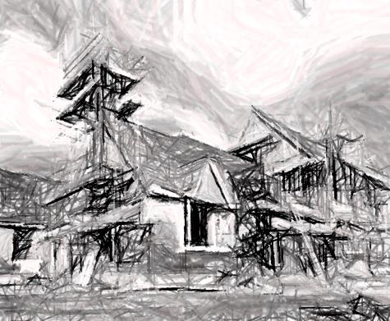
ESCP Inspections
Marin County Stormwater Pollution Prevention Program
San Rafael, California
November 12, 2015

Slide 2
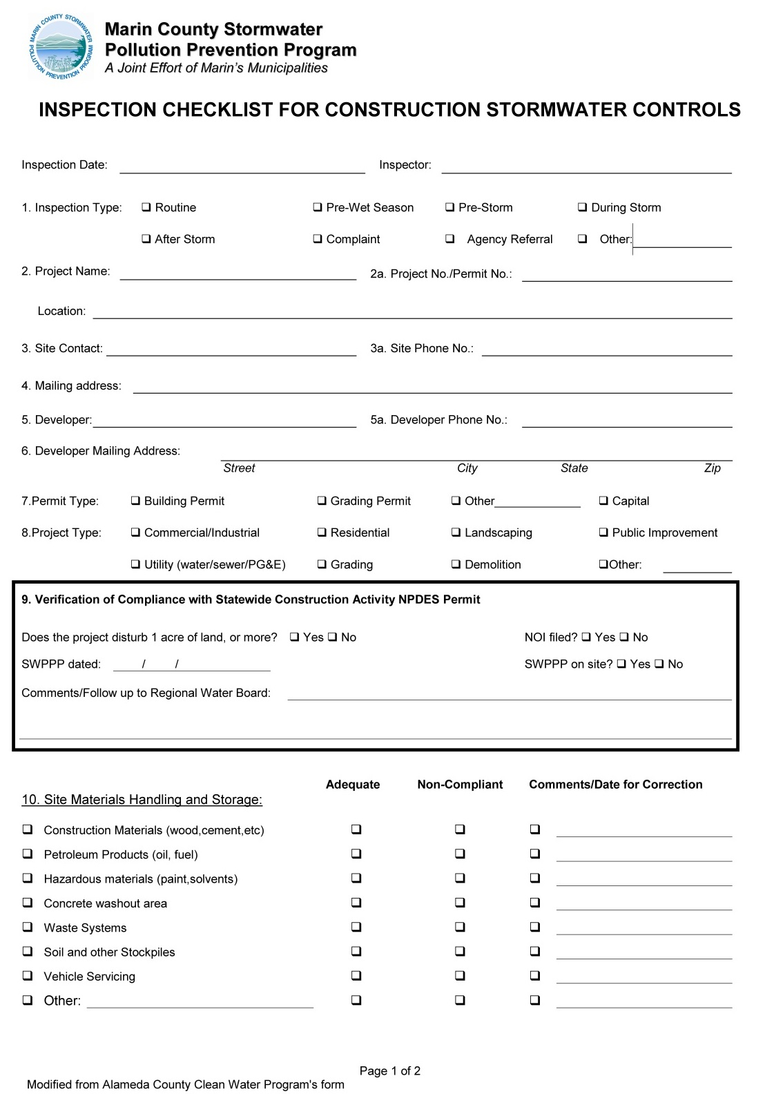
MSCTOPPP inspection checklist
Basic 2 page form
Allows inspectors to note if required BMPs are present and either adequate or non-compliant

Slide 3
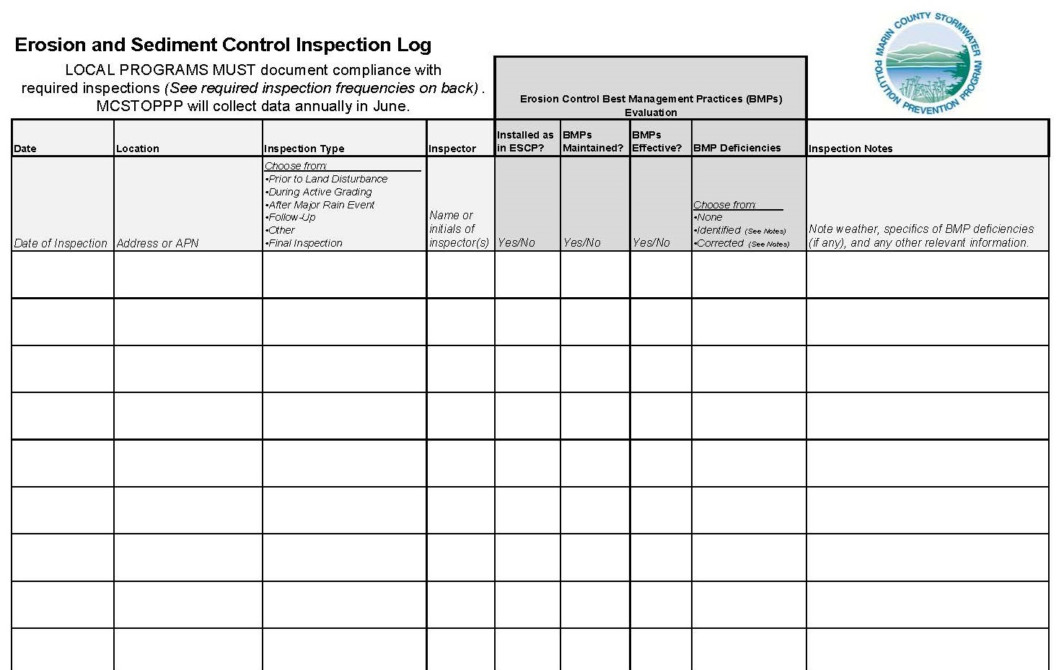
Inspection Log

Slide 4
Inspection log rolls up your inspection records
Date of inspection
Location of project/property
Inspection type
Inspector’s name/initials
BMP status
  Installed per plan
  Maintained
  Effective
  Deficiencies (none, identified, corrected)
Notes

Slide 5
Municipal inspection frequency
MCSTOPPP’s Construction Site Performance Standards requires inspections after each major storm event
Phase II Permit requires prioritizing inspections and conducting inspections at certain check points
MCSTOPPP Major storm event definition
“A storm or series of storms of such intensity or duration as to create significant quantities of runoff and potential for erosion. A series of storm events will be considered one major storm event if there is less than 72 hours of dry weather between storms.”

Slide 6
Municipal inspection frequency: “Normal priority”
Priority | Types of Projects | Inspection Requirements
Normal | Projects subject to ESCP Projects covered by the CGP Projects subject to the CGP waiver | Prior to land disturbance if starts during rainy season After each major rain event The agency can require the project proponent to conduct and document these inspections Once during active grading At conclusion of project
 | Projects on the Bolinas Mesa | Weekly inspections

Slide 7
Municipal inspection frequency: “High priority”
Priority | Trigger | Inspection Requirements
High | Projects with BMP implementation problems as determined by agency inspector or verified complaint | 1- 4 Same as above 5. Re-inspection after inspector identifies BMP problem or complaint to verify corrections Agency can require project proponent to submit proof (photo) demonstrating corrections have been made.

Slide 8
Construction operators need to inspection projects
Operator inspections check implementation of the ESCP and compliance with local ordinances
  Planned BMPs are implemented and effective
  No discharges of sediment laden water
  No discharges of construction wastes or materials (including litter)
Agencies can require projects to conduct post rain event inspections
CGP projects – must inspect per CGP required frequency
Notes:
Best practice – use check list to document inspection weekly. Site entrance needs to be inspected daily (or more frequently).

Slide 9
Role of the municipal inspector
Be familiar with the MCSTOPPP Standard ESCP Template
Use ESCP and Site Plan to guide site inspection
Recognize authorized and unauthorized non-stormwater discharges
Be familiar with standard construction site BMPs
  Understand what they are, how they work, and when to deploy them
Know who your QSP is and seek her/his advice on BMPs and ESCPs

Slide 10
Role of the construction operator
Use the ESCP and Site Plan to guide inspection
  Confirm planned BMPs are implemented and effective
Notify local agency when the ESCP needs to be changed
Recognize authorized and unauthorized non-stormwater discharges
Be familiar with standard construction site BMPs
  Understand what they are, how they work, how to install them, and how to inspect them

Slide 11
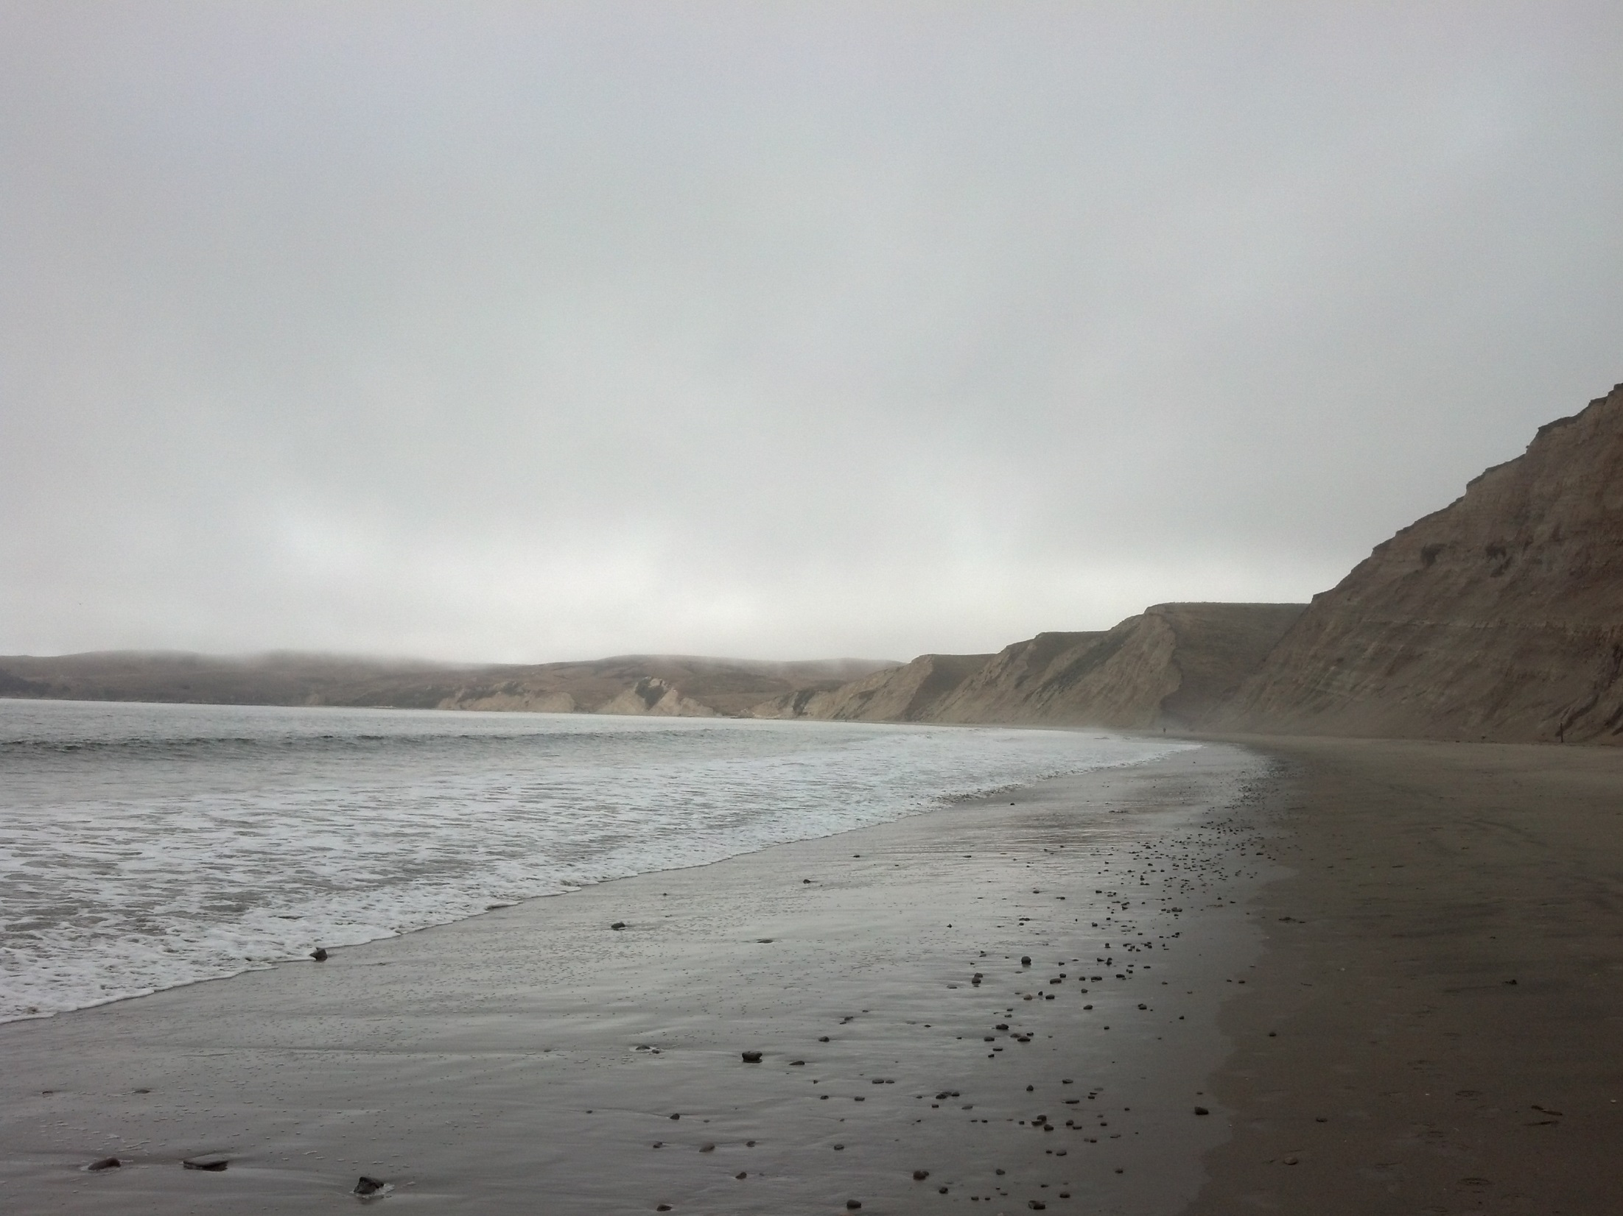
Questions

