Slide 1
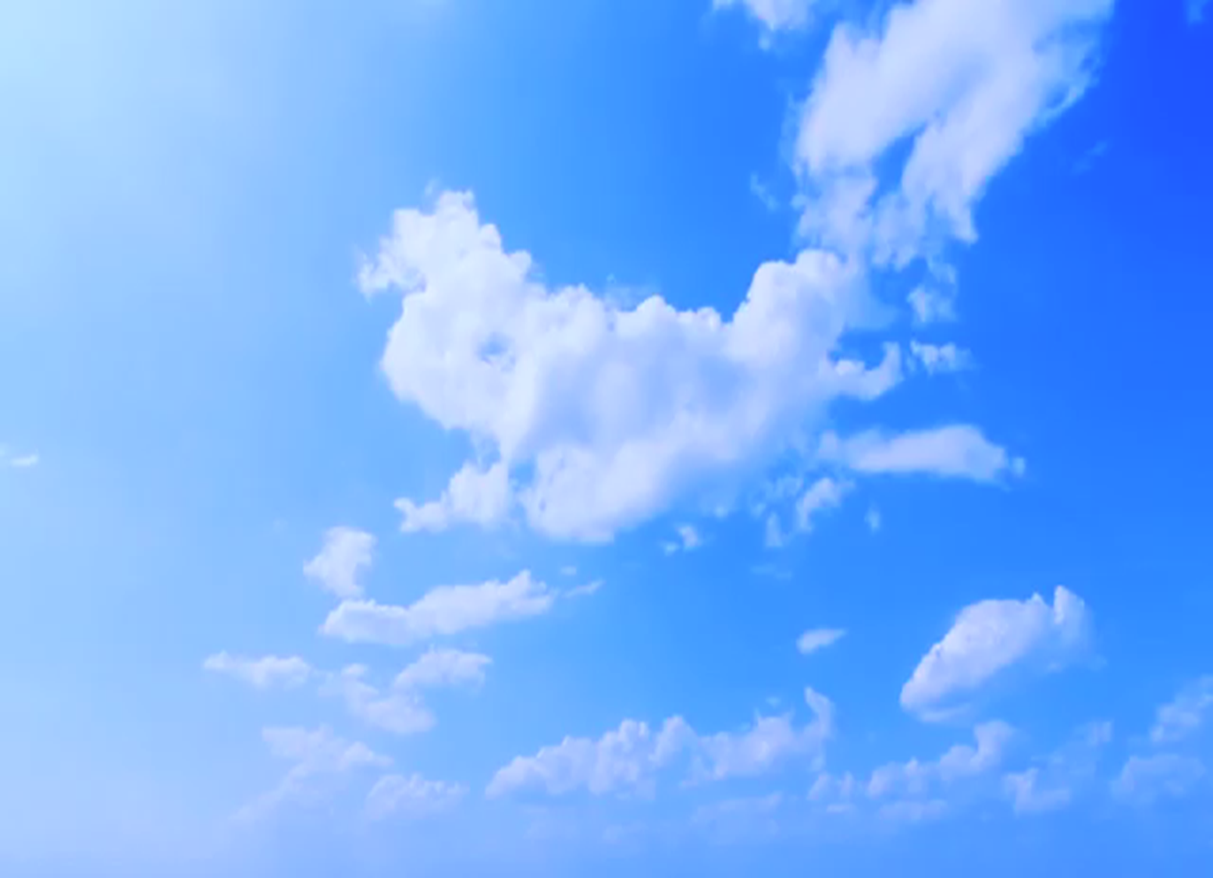
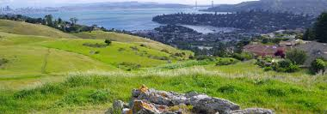
Welcome back!
What motivates you to participate in this group?
Notes:
10 min [4-4:10]

Slide 2
What We’re Discussing Today
Updates from Alex
Commitment to our Council
What can you do right now?
Subcommittee Updates + Breakout groups
Network Directory/Map
Outreach + Marketing Plan
Community Ambassadors
Progress Update + Next Steps
AGENDA
Notes:
5 min [4:15-4:20]

Slide 3
Our Progress
Stakeholder Collaboratives
Renewable Energy, Buildings + Infrastructure,
and Transportation: all working on designing projects
Carbon Sequestration kick-off on May 3rd
Steering Committee– 3 meetings so far
Funding: Marin Community
Foundation
Partnerships - DearTomorrow
Website: coming soon
UPDATE

Slide 4
Community Partnership Council
We are helping implement the vision of Drawdown: Marin:
Marin reverses its impacts on climate change by implementing local solutions, as we create a thriving, resilient, and equitable future for all.
Our role in this work is to:
Increase awareness of our initiative.
Gather community input
(“direct-lived experience”) and
refine projects
Inspire action
OUR ROLE
Notes:
5 min] 4:10-4:15
Refresher!
Increase awareness of our initiative – develop approaches and ideas for getting the word out about Drawdown, our progress to date, upcoming opportunities to engage, and what we are hoping to accomplish.
Gather community input (“direct-lived experience”) on the draft solutions developed by each of the 6 Collaboratives.
Inspire action – develop, with the help of a professional behavior change firm/company, a campaign that inspires the entire community to implement the solutions that help us achieve the Drawdown vision.

Slide 5
Commitment to Our Council
Can you attend monthly meetings?
Do you have time to serve on a subcommittee?
Do you just want to be
kept in the loop?
QUESTIONS TO CONSIDER
Notes:
[5 min] 4:20-4:25
Please consider what is your real ability to commit to this group. Consider these questions and let me or Leslie know before you leave today or over the phone or in an email.
We want you to participate, but need to understand where are the gaps and who is really committed so we can recruit additional folks if we need to increase our efforts/effectiveness.
Reminder of signed participation pledge – “I pledge to attend, be mentally and physically present, and come prepared to all meetings.” Can you still do it?

Slide 6
Sub-Committees
Network Directory/Map – Chris
Work session! 30 min.
Outreach + Marketing Plan
Draft Scope of Work – Leslie
UPDATES
Notes:
45 min (8 min for each update and 30 for work session) [5-5:45]
Network Directory – finish adding content
Outreach + Marketing Plan SOW – what do we need to add, what can we do versus a third party, how much will it cost?

Slide 7
What can we do right now?
Can you help us get the word out?
Raise awareness of Drawdown: Marin –
what is it and what are our goals?
Ask people to take action now!
Community Ambassadors
(more on this later)
Events Tracker
DRAWDOWN: Marin
AMBASSADORS

Slide 8
Purchase 100% Renewable Energy
Drive less, drive smarter
Upgrade your lighting
Support local farms and reduce waste by only buying the food
that you will consume
WHAT
CAN YOU DO
RIGHT NOW?
Support sustainable agricultural
practices that drawdown carbon
Start a Resilient Neighborhoods
team at home or at work
Notes:
Transition from Chris to Leslie
Just a refresher on the six focus areas and what people in our communities can do now:
Renewable Energy: Sign up for Deep Green with MCE Clean Energy, or PG&E. Using renewable electricity like wind and solar reduces demand for dirtier power sources like natural gas.
Transportation: Can you bike instead? Can you carpool with your friends? Can you walk even though you may not want to? What about public transit? Cars are convenient but pollute our air and cause traffic congestion in and outside of Marin County. Commit to making your next car a hybrid or electric vehicle
Buildings/Infrastructure: Switch your existing lighting to more energy efficient LED lighting. LED light bulbs use about 90% less energy than incandescent bulbs and can last up to 10 years. And as appliances need to be replaced, switch out your gas dryer or furnace or water heater with an electric model
Local Food/Food Waste: Consider buying only the food you really need for a meal, a day, or a week to save money and reduce waste. Visit Zero Waste Marin.
Carbon Sequestration: The Marin Agricultural Land Trust (MALT) is working with local farms to develop and advance climate-friendly practices like rotational grazing, stream restoration, and methane capture. Encourage tree planting in local parks.
Climate Resilient Communities: Our small daily decisions have impacts on our community. Resilient Neighborhoods gives you the information you need to make positive choices. Understand the local and regional risks of sea level rise and climate change.
There is information on all of these actions and more at the table in the back – so please take a look and take home the information that is useful to you taking your next steps.

Slide 9
RENEWABLE ENERGY
TRANS-PORTATION
CARBON SEQUES-TRATION
CLIMATE RESILIENT COMMU-NITIES
FOOD AND FOOD WASTE
BUILDINGS AND INFRA-STRUCTURE
Drawdown Advisors
DRAWDOWN: Marin COORDINATOR
WHAT DOES
THIS LOOK LIKE?
Notes:
The CPC will have more information on local projects to share with the community as the collaborative working groups bring their proposals to the Ex Steering Comm.
The CPC is integral to making the community aware of this effort.
Remember: people want to do something, they just do not know where to start.
DRAWDOWN: Marin is here to give coherent messaging about what people can do now, and in the future.
Everyone here is important to this effort. You are Drawdown Ambassadors

Slide 10
Ambassadors: Why do we need your help?
To raise awareness & inspire our community!
What will I be doing?
Attend Events • Deliver Talks • Identify Events • Raise Awareness
What skills do I need?
Friendly • Reliable • Confident • Organized
How much time would you like?
One Event per month • flexible, based on your schedule
How will I be trained and supported?
Talking Points • PowerPoint presentations • Practice • Equipment Materials • Flyers
What can I gain from volunteering with you?
Satisfaction • Valuable Contribution • Learn New Skills • Utilize Existing Experience • Make New Connections • Expand Relationships
Notes:
Why do we need your help?
Drawdown: Marin needs your help both to raise awareness of the initiative and to inspire our community to act to dramatically reduce our greenhouse gas emissions by implementing local solutions.
What will I be doing?
This is a varied role and you could do one, some, or all the following activities:
Attend events in the community on behalf of Drawdown: Marin
Distribute Drawdown: Marin flyers
Discuss our effort with other attendees
Set up and staff a table; distribute Drawdown: Marin flyers and other program (ZeroWaste, MCE Clean Energy, Electrify Marin, etc. materials)
Deliver talks to local community groups, schools, faith groups, etc. about the work of Drawdown: Marin and the ways they could help us achieve our goals and we help them
Identify events and other opportunities to raise awareness of Drawdown: Marin
Raise awareness of Drawdown: Marin by talking to friends and family and on social media
What skills do I need?
A personal and friendly communication style
Reliable and professional demeanor
Confident public speaker with excellent communication skills
Excellent organizational skills
How much time would you like?
This is a flexible role and the times may vary but hope you will attend at least one event per month.
How will I be trained and supported?
The Drawdown: Marin Coordinator and Community Partnership Council Chair will provide talking points, access to PowerPoint presentations, provide practice sessions for presenters, and will be available if you have questions
You will be given any equipment, materials, and information needed for your events
What can I gain from volunteering with you?
The satisfaction of knowing that you are making a valuable contribution to reversing Marin County’s impacts on climate change
Develop and learn new skills that utilize and build on your existing experience
Meet new people and make new connections while you contribute to increased community awareness of Drawdown: Marin, expanding relationships within our communities, and building trust in local government

Slide 11
Effective Presentations
Understand your audience
Develop your main points
Launching statement
Manage expectations
and Manage stage fright!
Make team presentations
Follow-up on action items, get audience feedback, interest sign-ups, etc.

Slide 12
The overarching goal for this team
is to effectively launch the DRAWDOWN: Marin community-wide campaign,
reaching all sectors and communities in Marin County.
The goal of the campaign
is to move Marin County
to dramatically reduce our
greenhouse gas emissions and
do our part to slow the impacts
of climate change to protect
future generations.
OUR SCOPE OF WORK

Slide 13
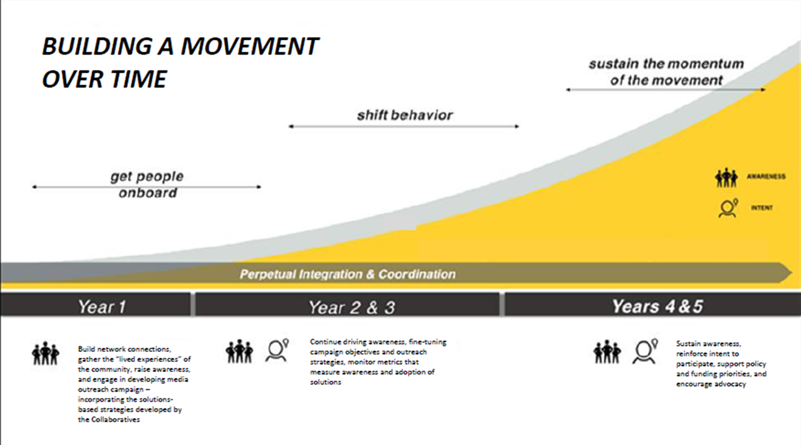
Notes:
Year One:
Build network connections, gather the “lived experiences” of the community, raise awareness, and engage in developing media outreach campaign – incorporating the solutions-based strategies developed by the Collaboratives
Years Two and Three:
Continue driving awareness, fine-tuning campaign objectives and outreach strategies, monitor metrics that measure awareness and adoption of solutions
Years Four and Five:
Sustain awareness, reinforce intent to participate, support policy and funding priorities, and encourage advocacy

Slide 14
Pre-Planning: January – June, 2019
Map community networks and identify leaders
Identify audiences/constituencies of Marin community organizations
Table, attend events, and make
presentations to add visibility
of “DRAWDOWN: Marin”
Develop partnerships and
engagement opportunities
OUR SCOPE OF WORK
Notes:
PRE-PLANNING: JANUARY – JUNE, 2019
While the Stakeholder Collaboratives are drafting their contributions to the “roadmap”, the CPC will organize itself into interest and skills sub-committees and will set the stage for the campaign:
Map all community networks and identify leaders in each network:
including names, websites, contacts of nonprofits, businesses, HOA/community organizations, service organizations, local jurisdictions and sustainability commissions, educational institutions, etc. –
Identify audiences/constituencies of Marin community organizations -
Reach
Geography
Demography
Economic profile
Education
Associate key market and psychographic motivators for these organizations, i.e., what messaging related to Drawdown: Marin initiatives is likely to repel/appeal to them? What are the values and focus for the organization?
What are key Strengths, Weaknesses, Opportunities, Threats for each? What is the key communications path for each demographic/organization?
Outline how those can be leveraged to promote Drawdown: Marin
Table and attend events to add visibility for the name and future “DRAWDOWN: Marin” campaign
Develop partnerships and engagement opportunities (businesses, non-profits, schools, etc.)
Outreach opportunities
E-newsletters
Co-Sponsorships
When and how do we ask for the “direct-lived experience” of community members? This is tough because we’ll have some actions we can seek input on but no $ to do it. Example: RE Go 100 campaign thinks $ is the barrier to getting folks to install solar. Ideally, we’d ask the community if that’s true. But, we don’t have the resources to do that in a meaningful way (get a large enough sample size). Also, the Collaboratives are coming up with their own engagement ideas – the CPC should vet those and suggest other ideas? Should we wait for the consultant to help us?
I don’t see this as an issue in the phase at all – right now I’d just be happy to have people signing up and excited to march in a parade or table at an event.

Slide 15
The CPC & the Communications Sub-Committee Team
CAMPAIGN PREPARATION: JULY - OCTOBER
Continue refining the Pre-Planning actions
Engage Network Leaders
OUR SCOPE OF WORK
Notes:
CAMPAIGN PREPARATION: JULY - OCTOBER
The CPC, in consultation with the Executive Steering Committee and the 6 Stakeholder Collaboratives, will take strategy information and begin laying the groundwork for the campaign itself:
Continue refining the four Pre-Planning actions
Mapping Network, Tabling, Events, Presentations, Letters to Editor, etc.
Engage Network Leaders
The Marketing/Communications Sub-Committee will:
Determine metrics of successful engagement
Draft Request for Qualifications/Proposals (RFQ, RFP) for marketing/messaging campaign consultant (with input from Alex and ESC)
Interview and engage campaign consultant
Working with campaign consultant, create detailed campaign strategy and budget
To Be Determined:
Ramp up fundraising to meet campaign budget requirements (ESC?)
Test messaging in community focus groups (consultants and/or CPC)
Engage the community to review the Draft Roadmap and receive input
And decide if the CPC can do this or if we should pay someone to do it along with developing a fundraising strategy.
There are at least a few of us who can draft an RFP. The ESC will need to partner on that, but between you, Kate and certain members of the CPC, there is plenty of experience to draft this. Not worries at all.
We need to start fundraising now, right?
Well, yeah…
Are you talking about the Roadmap document on the website? What kind of feedback are you looking for?
We’ve been talking about getting community feedback, and doing some community workshops as the roadmap comes together. Let me know if that is off the table.

Slide 16
The Marketing/Communications Sub-Committee Team
Determine metrics of successful engagement
Draft Request for Qualifications/Proposals (RFQ, RFP) for marketing/messaging campaign consultant
(with input from Alex and ESC)
Interview and engage
campaign consultant
Working with campaign
consultant, create detailed
campaign strategy and budget
OUR SCOPE OF WORK
Notes:
The Marketing/Communications Sub-Committee will:
Determine metrics of successful engagement
Draft Request for Qualifications/Proposals (RFQ, RFP) for marketing/messaging campaign consultant (with input from Alex and ESC)
Interview and engage campaign consultant
Working with campaign consultant, create detailed campaign strategy and budget
To Be Determined:
Ramp up fundraising to meet campaign budget requirements (ESC?)
Test messaging in community focus groups (consultants and/or CPC)
Engage the community to review the Draft Roadmap and receive input

Slide 17
Gathering Audience Insight
Achieve an accurate portrait of groups, perceptions, concerns
Understand the factors that affect perception
Determine the channels and
sources of information
OUR SCOPE OF WORK

Slide 18
Gathering Insights, like…
Community concerns and priorities on sustainable projects
Barriers to adopting solutions
Community satisfaction with government actions
Local economic conditions
Local empowerment and collaboration opportunities
Notes:
Identify Partners & Win-Win Relationships
Create network directory with entity, contact info, causes, targets, channels, reach, events, collaboration plans (started)
Establish a win-win foundation: first seek to understand, then communicate and strive to find commonality and collaboration

Slide 19
And…
Underlying views: Can any overarching views on climate change, fossil fuel-based energy, alternative energy source, coal mining, drilling, oil and gas production, natural gas storage
Trust: Who do the stakeholders trust? Why are these individuals trusted?
Media: Where do individuals get their information? Is there a strong local media presence? Are there any “natural allies” in local media?
Local education: What educational resources are in the area – community colleges, universities, schools? Are there opportunities to collaborate?

Slide 20
Let’s teach people about
DRAWDOWN: Marin!
Choose a partner
and see if you both can answer these questions:
What is Drawdown: Marin?
How can you get involved in the effort?
What have we done so far?
What kind of projects will
come out of this process?
GROUP EXCERCISE
Notes:
15 min for activity and 10 min to debrief [4:35-5]

Slide 21
Finish Network Directory and begin to map out connections and ideas for reaching out to these groups
Outreach + Marketing Plan Subcommittee finalizes draft SOW before next meeting
Collaboratives ask Council for ideas on how to integrate direct-lived experience of the community into draft solutions/projects
Next meeting is
Wednesday, May 29th.
NEXT STEPS
Notes:
8 min [5:52-6]

Slide 22
DRAWDOWN: Marin
Local solutions to the global climate challenge.

