Slide 1

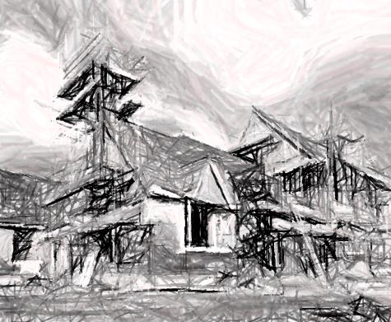
Construction Stormwater Best Management Practices
Marin County Stormwater Pollution Prevention Program
San Rafael, California
November 12, 2015

Slide 2
Disclaimer
The mention or image of any product or service is for illustrative purposes and is not an endorsement of the product or service.

Slide 3
Basic principles of stormwater quality protection
BMP Principles
Minimize pollutant exposure
  Don’t expose potential pollutants to wind and rain
Protect exposed pollutants
  Keep pollutants from being washed or blown away
Use and maintain Best Management Practices (BMPs)
  Procedures to minimize exposure or techniques to remove pollutants from runoff
Use BMPs in layers to protect water quality and plan for accidents

Slide 4
A few common sources of water pollutants on construction sites
BMP Principles
Material | Pollutant | Effect on Creeks
Dirt and Dust | Sediment | Fills habitat, clogs gills, impairs ability to hunt
Concrete wastewater | pH | Toxic to aquatic life
Concrete wastewater Vehicle fueling & maintenance | Metals | Toxic to aquatic life
Paints and solvents | Synthetic organic compounds | Toxic to aquatic life
Landscape trimmings and fertilizers | Nutrients | Causes algal blooms, depletes oxygen
Landscape trimmings | Biochemical oxygen demand | Depletes oxygen
Asphalt/Paving Vehicle fueling & maintenance | Oil & grease | Causes sheen, toxic to aquatic life

Slide 5
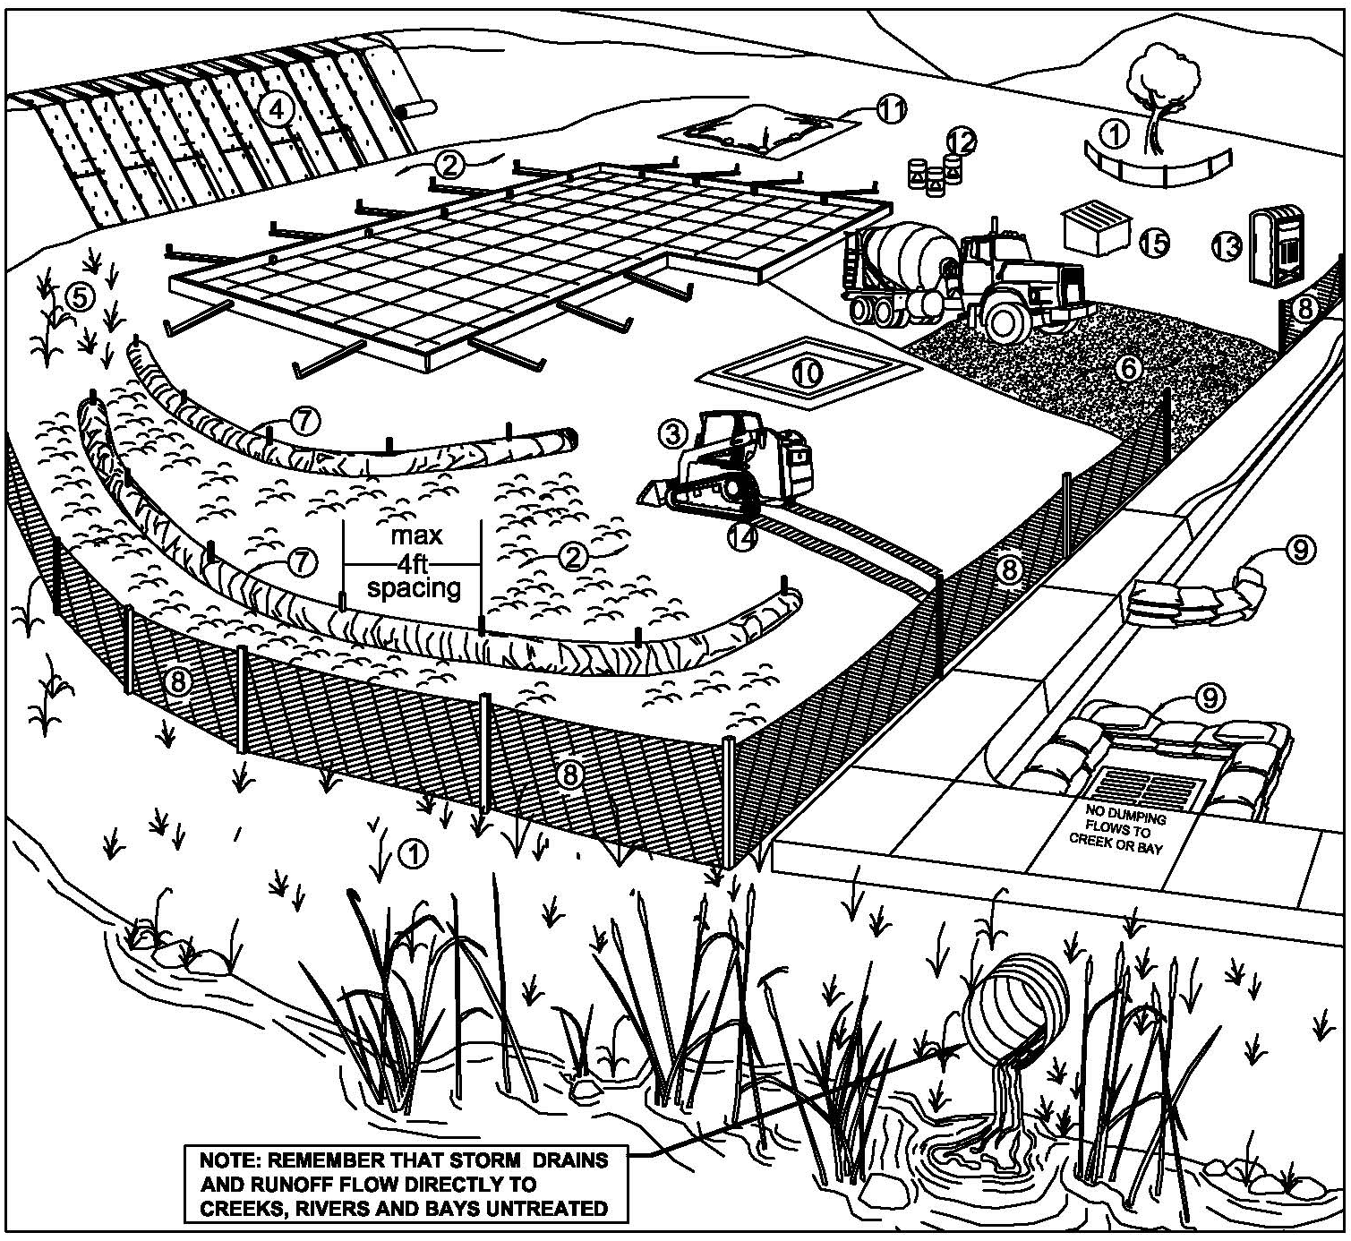
Layers of BMPs
BMP Principles

Slide 6
Connecting the dots between BMPs and activities
BMP Principles
Construction Activities
BMP Categories
Grading
Concrete
Trash
Clearing
Painting
Fueling
Landscaping materials
Erosion Controls
Sediment Controls
Good Housekeeping

Slide 7
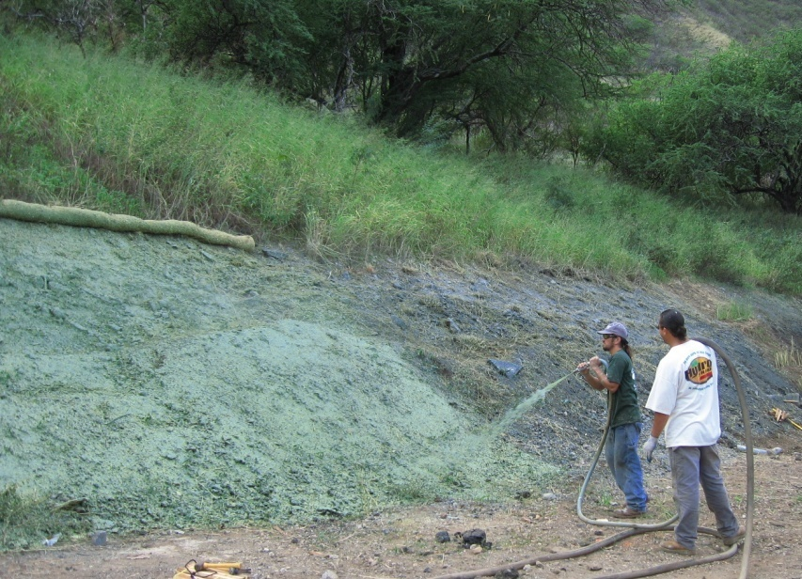
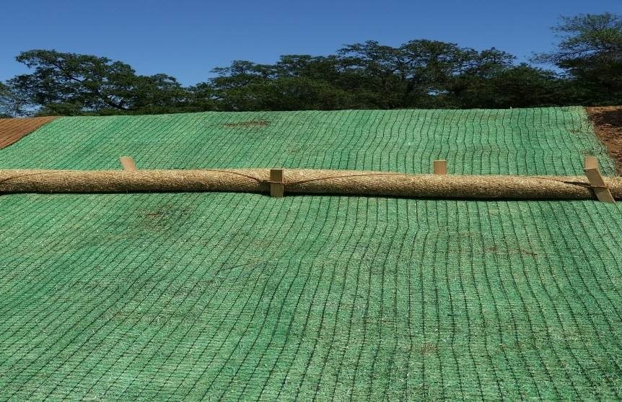
Erosion Control
BMP Principles
Protects soil and prevents soil particles from becoming detached by rainfall, flowing water or wind
Soil protected as a resource
Source controls that prevent soil from becoming a pollutant
Notes:
Erosion control are the most important type of practices to prevent soil leaving a construction site.
When we start a construction project the initial work removes the existing soil cover – typically vegetation – sometimes hardscape. The clearing of the site, removes the protective cover that prevents erosion.
Soil can be eroded by wind blowing (wind erosion), rain drops hitting the soil (splash erosion), or by the force of water flowing over the surface (sheet and rill erosion).

Slide 8
MCSTOPPP Minimum Control Measures
BMP Principles
Erosion Controls
Scheduling
Protect existing vegetation
Creek set backs
Soil cover
Soil preparation/roughening
Erosion control blankets
Revegetation

Slide 9
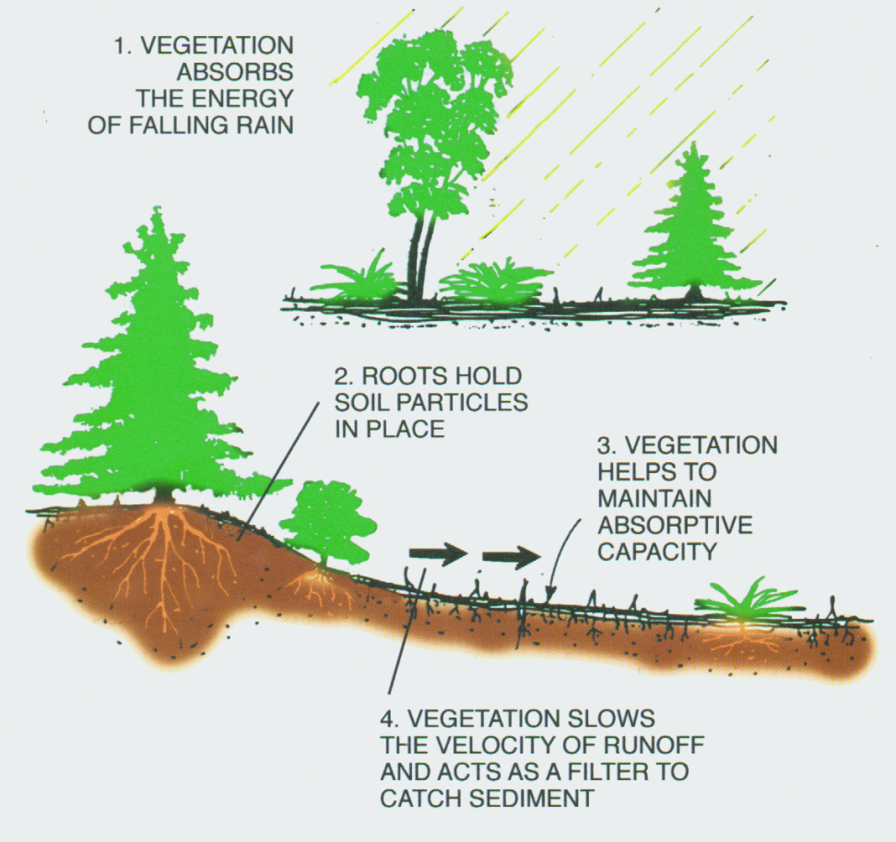
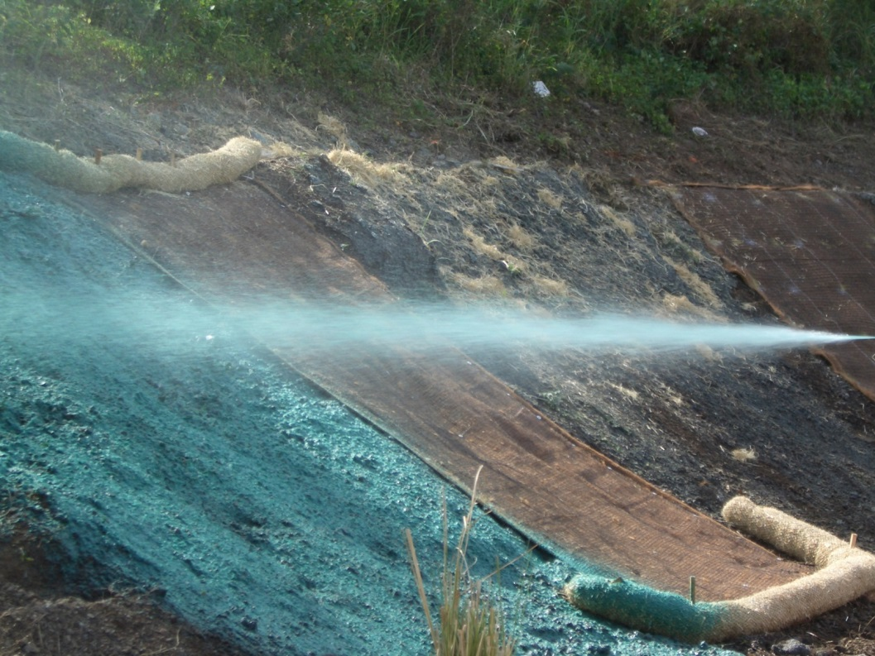
Benefits of vegetation
BMP Principles

Slide 10
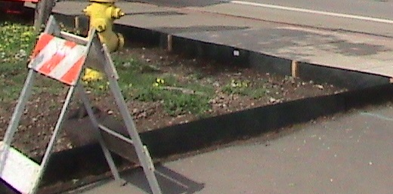
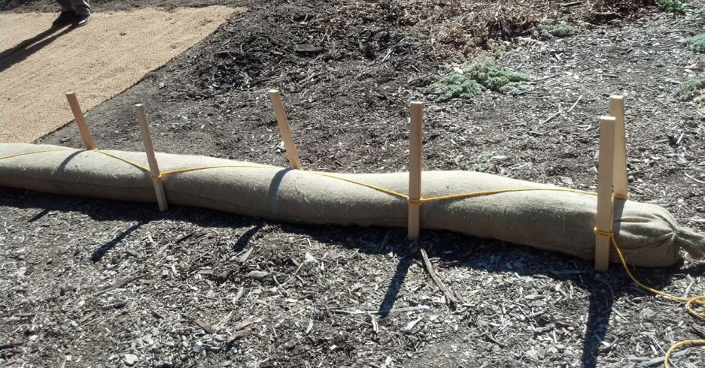
Sediment Control
BMP Principles
Practices that trap dirt particles – sediment – once they have been detached by rain, flowing water, or wind
  Various practices to slow and detain water to allow sediment to settle
  Treatment controls that remove soil from water or wind
Notes:
Sediment controls should be used as a back up for erosion controls.
These controls remove sediment particles from water or wind, but they are not very efficient or effective on a construction site.
The controls for the most part rely on slowing the water (or wind) down enough so that the particles can drop out by gravity. Some practices spread concentrated flows so they don’t create gullies.
They are ineffective because the sedimentation process takes a long time and or a lot of space. This is time and space we don’t have on a construction site.
Very few practices can filter sediment out of water. Most sediment particles are very small. Effective filters would pass water very slowly or clog and potentially cause flooding.

Slide 11
MCSTOPPP Minimum Control Measures
BMP Principles
Sediment Controls
Tracking controls
Fiber rolls (wattles)¹
Silt fence¹
Drain inlet protection
Trench dewatering
¹Manufactured linear sediment controls

Slide 12
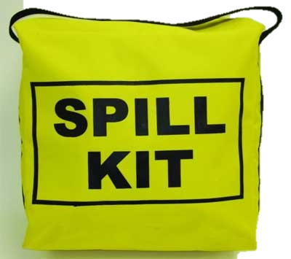
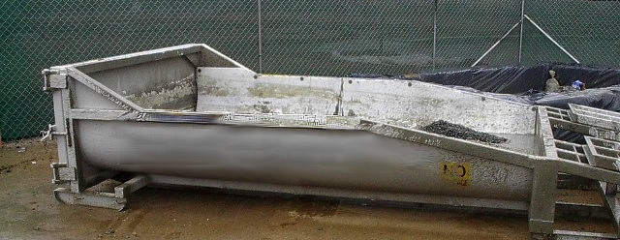
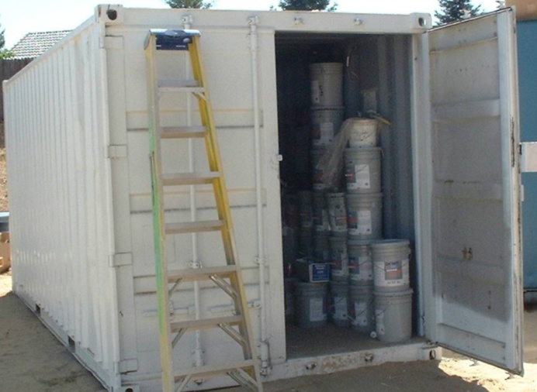
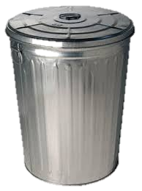
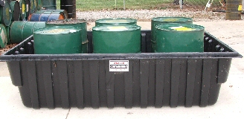
Good Housekeeping
BMP Principles
Source control practices that minimize exposure of construction materials and waste to rain and wind
Notes:
These practices focus on all the other sources of pollutants at the construction site.
Use of spill containment systems, sheds and covers to keep rain from contacting materials or wastes, implementing procedures to ensure vehicles are serviced (in a way that doesn’t release pollutants), fuel storage practices …

Slide 13
MCSTOPPP Minimum Control Measures
BMP Principles
Good Housekeeping Practices
Concrete washout
Stockpile management
Hazardous material management
Sanitary waste management
Equipment and vehicle maintenance
Material storage
Litter and waste management

Slide 14
Erosion Control BMPs

Slide 15
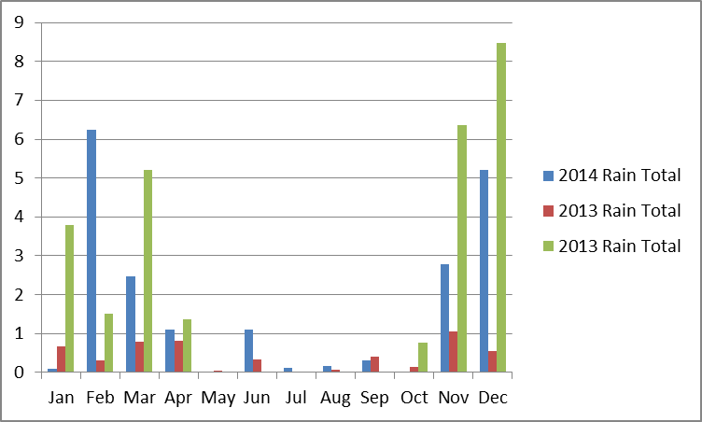
Scheduling
Erosion Control BMPs
Integrate BMP implementation with activities
  Phase grading to limit amount of soil exposed
  Avoid grading during rainy periods
  Stabilize graded areas that become inactive
  Adjust activities based on predicted weather
  Re-vegetate during
  the appropriate growing
  conditions
  Comply with local
  winter work prohibitions
Black Point Novato, Data Source UCCE
Notes:
No it doesn’t mean you have a construction schedule!
Sequence and plan BMPs implementation based on weather and activities.
Some communities may prohibit work during the ‘rainy season’. Be forewarned that work in the winter, when we get most of our rain, BMPs will be more expensive.
Data in inches.

Slide 16
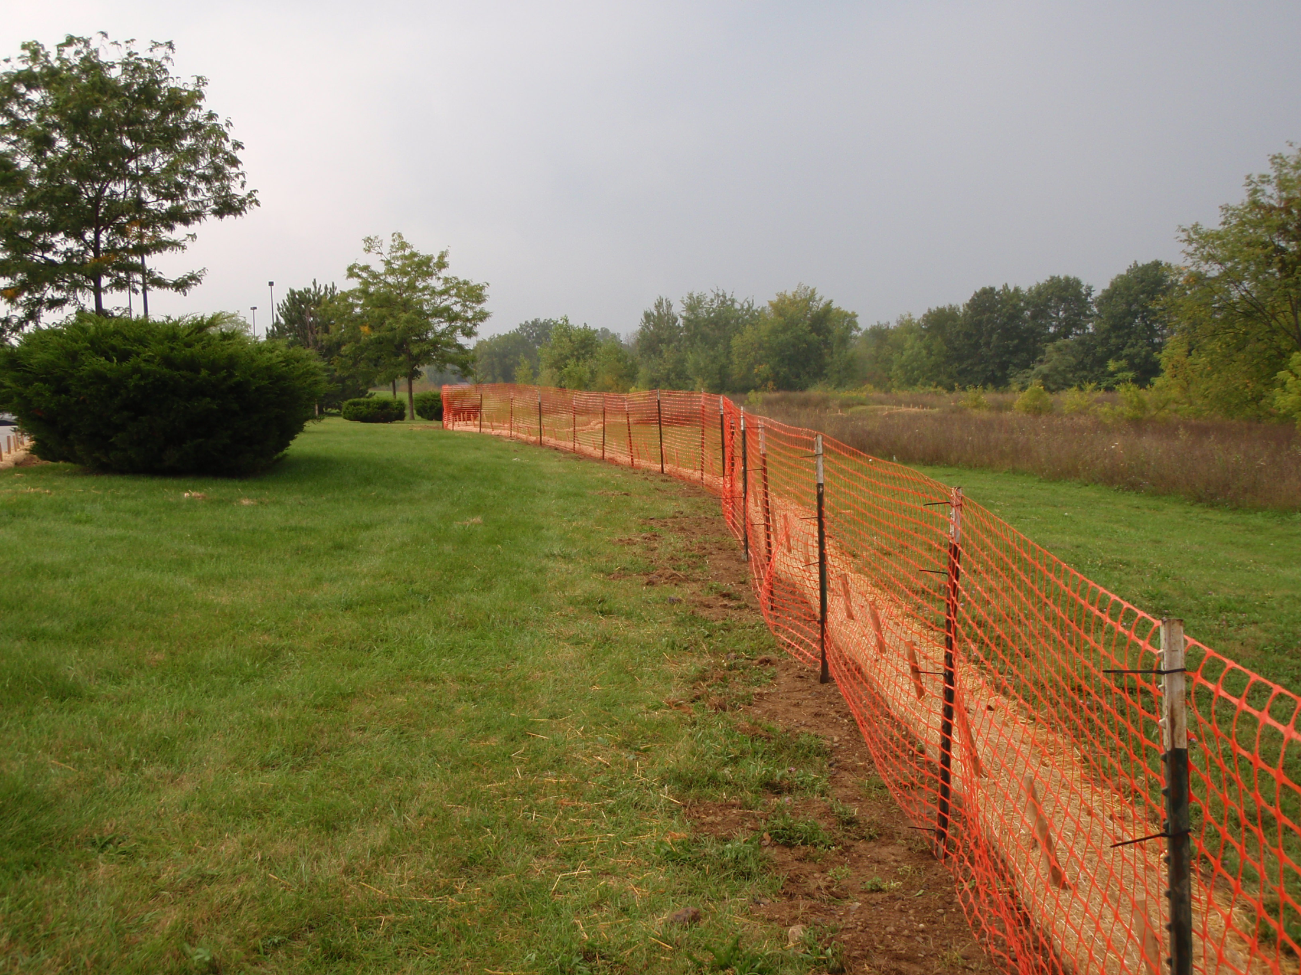
Preserve vegetation and creek setbacks
Erosion Control BMPs
Clear delineation
Ideally 25+ feet from creek
(or as required by local ordinance)
Preserve existing vegetation in buffer
Install before construction starts
Notes:
Look for clear

Slide 17
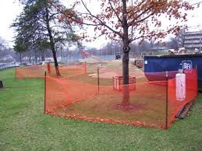
Preserve vegetation
Erosion Control BMPs
Protect trees from construction
Establish protective zone around drip line of tree

Slide 18
Soil cover
Erosion Control BMPs
Generic term for a variety of temporary BMPs that apply an erosion resistant cover to disturbed soil
  Straw mulch
  Hydraulic mulch
  Soil binders
  Wood mulch
  Compost blankets
  Non-vegetative stabilization

Slide 19
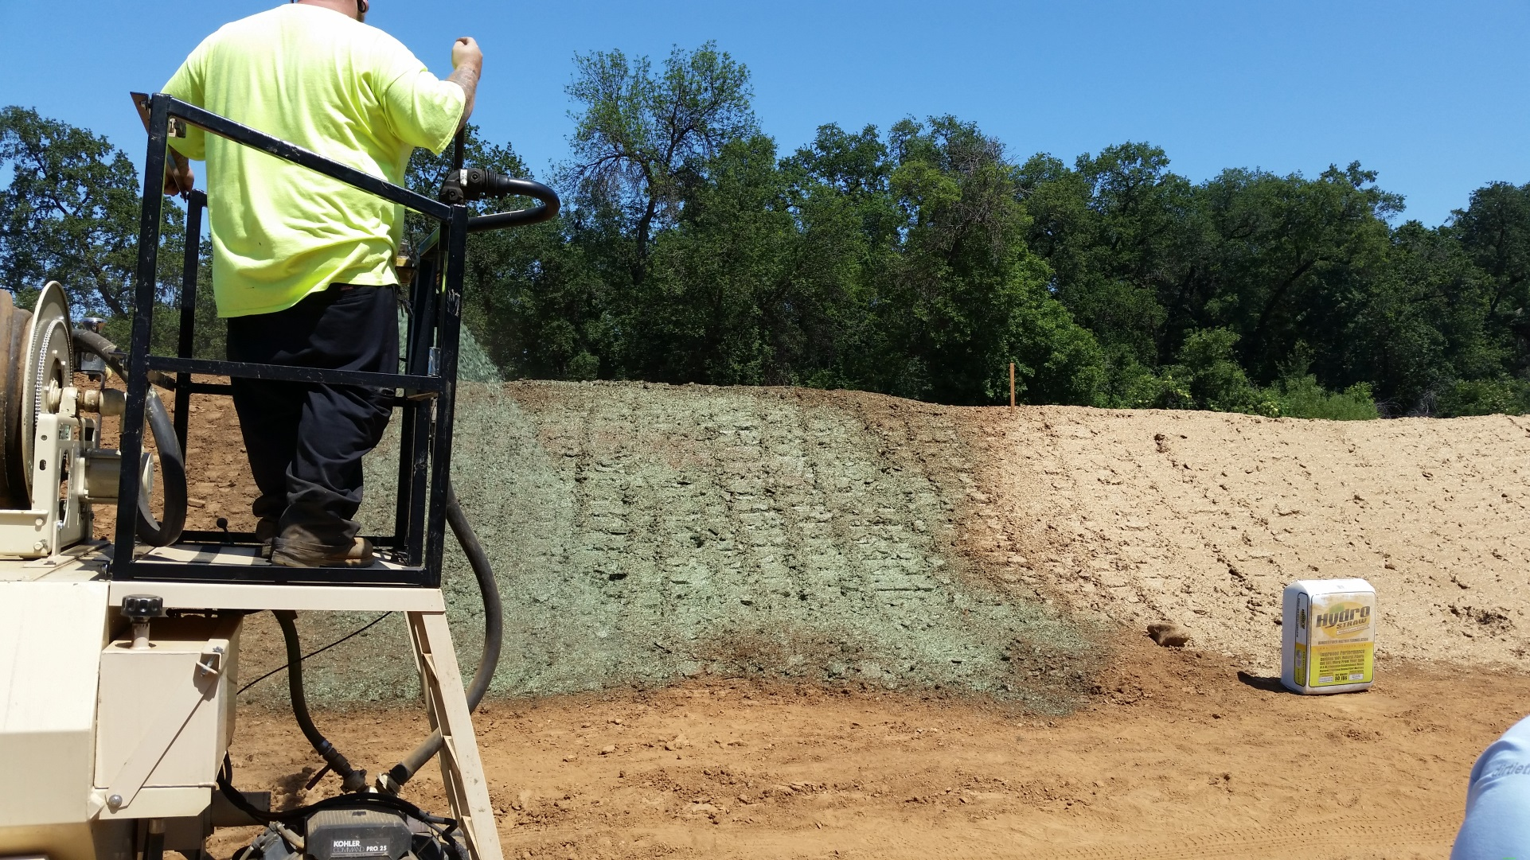
Track walked slope treated with hydromulch

Slide 20
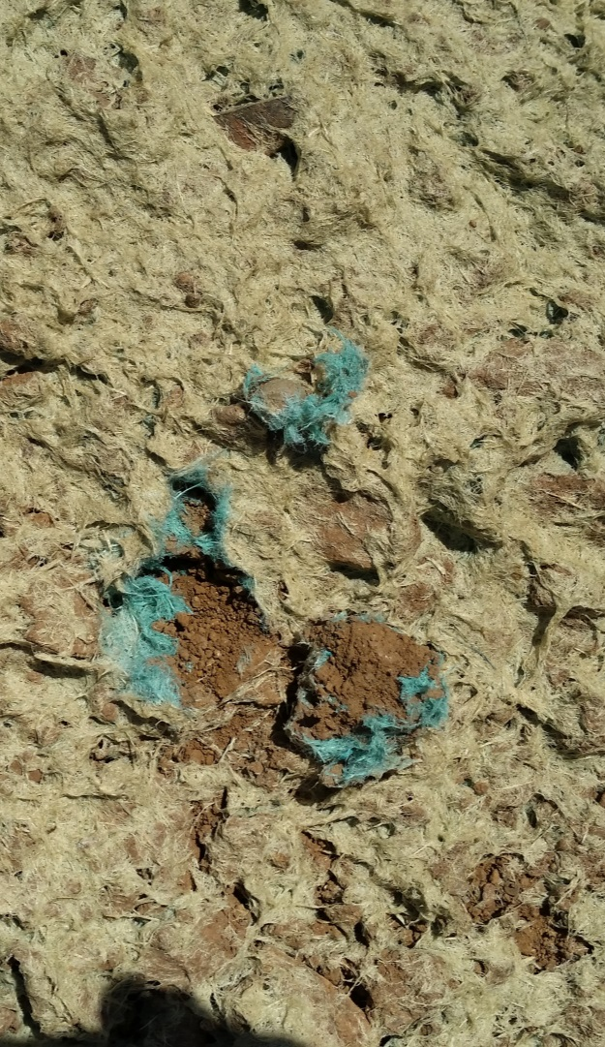
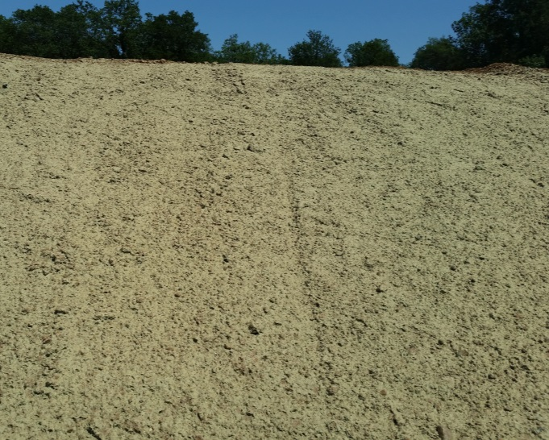
Slope treated with hydromulch

Slide 21
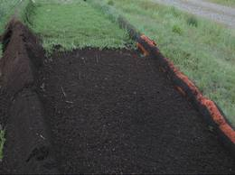
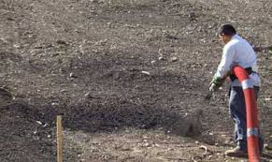
Compost blankets
Erosion Control BMPs
Pneumatic blower typically used to place compost
Roughen surface before application
1-4-inches thick
Seed can be incorporated
Slopes 2:1 or gentler
  Tackified on steeper slopes

Slide 22
Soil preparation and roughening
Soil Preparation includes raking, tilling, and incorporation of soil amendments to foster growth
  Typically part of the establishment of permanent vegetation
Soil Roughening includes track walking, stair stepping, decompacting soil to increase its resistance to erosion
  Employed for both temporary erosion control and permanent vegetation
  Used with soil cover and erosion control blankets

Slide 23
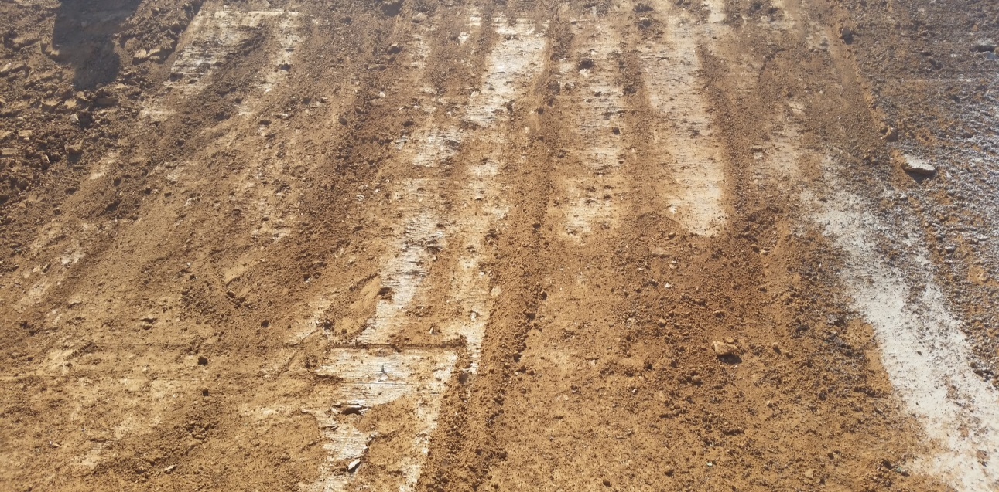
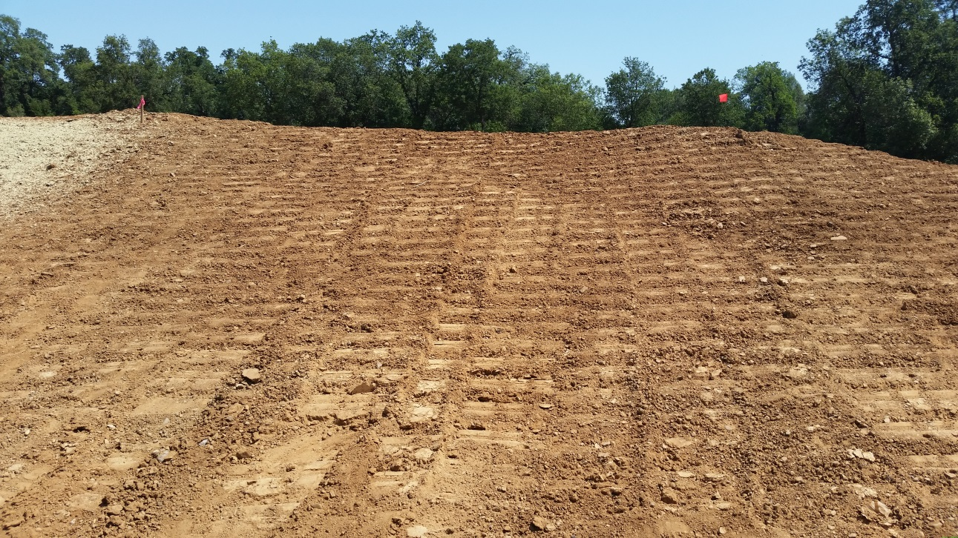
Comparison of smooth and track walked slopes
Smooth compacted slope little opportunity for vegetation to take hold
Lots of pockets to catch water, soil, and seed
Notes:
Reduction in erosion from track walked slopes (alone) 12-76%.

Slide 24
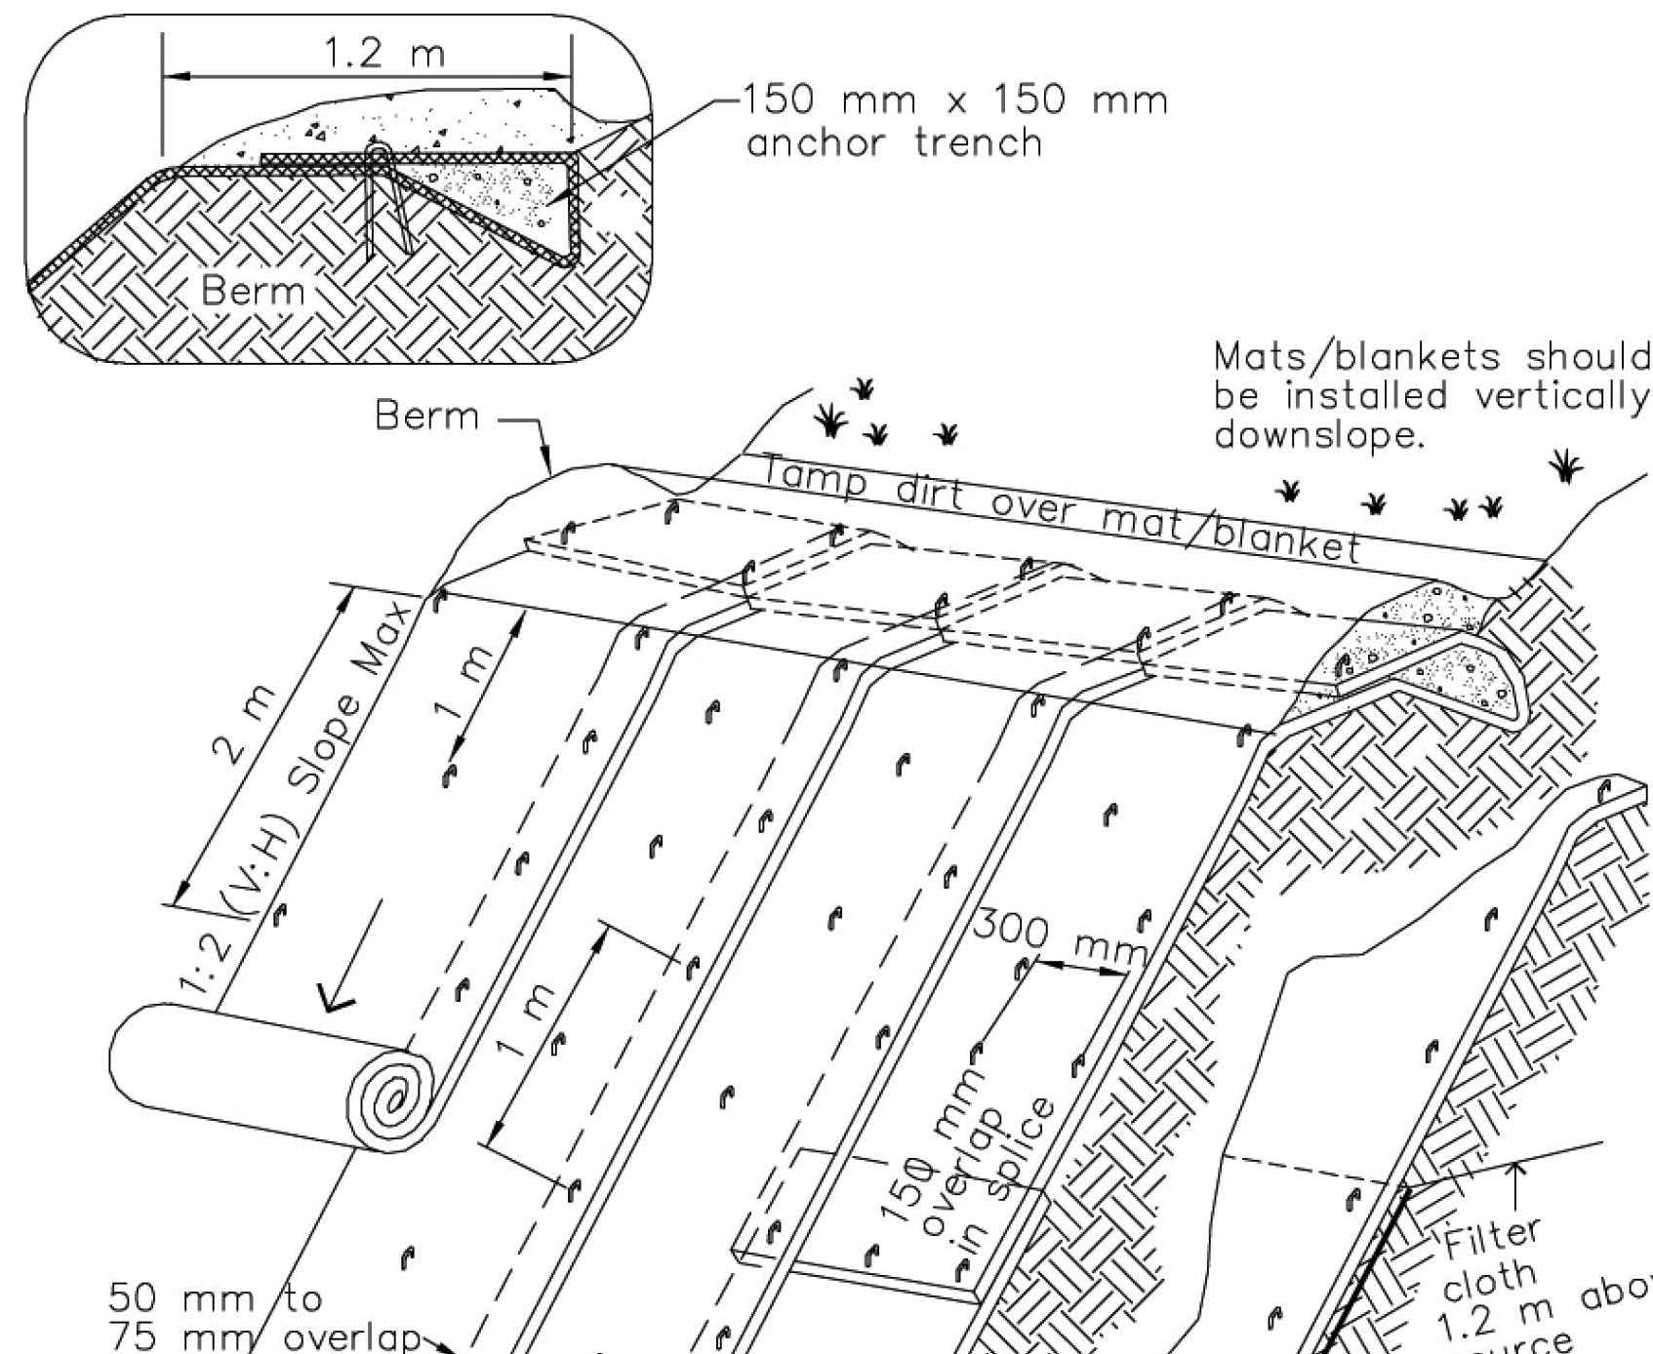
Erosion control blankets
Anchor top to secure blanket and prevent undercutting
Install vertically downslope
Overlap (shingle) panels
Staple to secure to soil
Do not stretch blanket

Slide 25
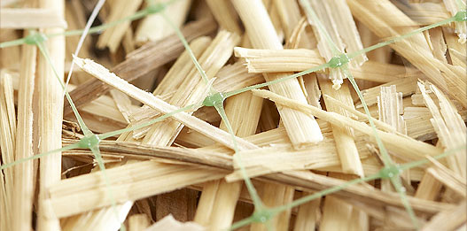
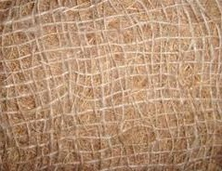
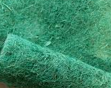
Wildlife friendly products
Avoid erosion and sediment control products that contain plastic nets (fixed aperture)
  Never use products that contain plastic nets for any BMP that will be part of the final stabilization
Use BMPs made of natural material without plastic nets

Slide 26
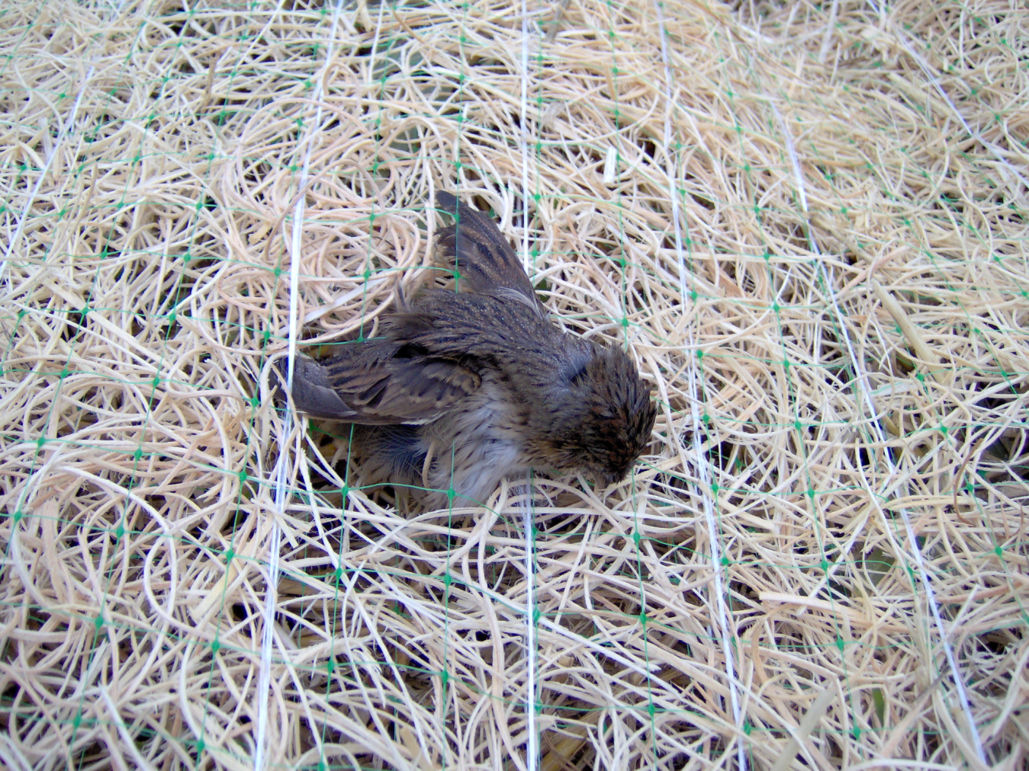
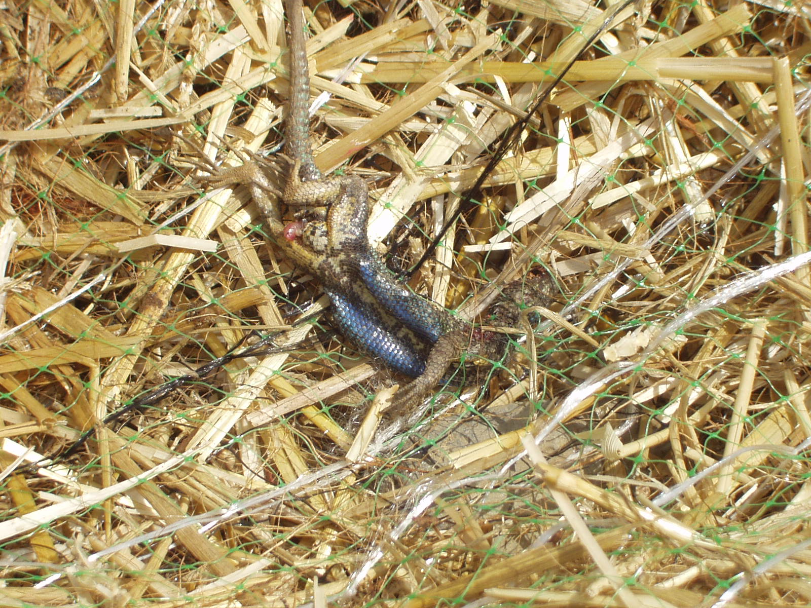

Slide 27
Sediment Control

Slide 28
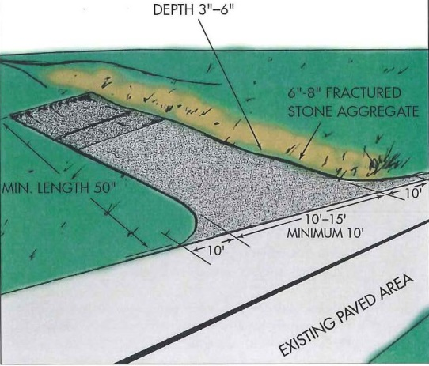
Tracking control
A system of practices to minimize dirt from the project getting onto the roads and subsequently washed into storm drains
  Stabilized entrance
  Sweeping
  Access restrictions
    Limit access to stabilized entrance –
    no short cuts
    Limit access to necessary vehicles only
  Tire wash (optional, as needed)

Slide 29
Stabilized entrance/exit
Sediment Control BMPs
Size based on size of vehicles that will access site, bigger tires need longer entrances
  Typical BMP fact sheets are based on large trucks
Marin BMP adapted for smaller sites assuming light trucks would be the typical vehicle
  On smaller sites, install maximum length site can accommodate
  Install to allow two full rotations of tires on the entrance material
  Augment with rumble pads or racks
  Consider graveling access area/road
Notes:
Take entrance right

Slide 30
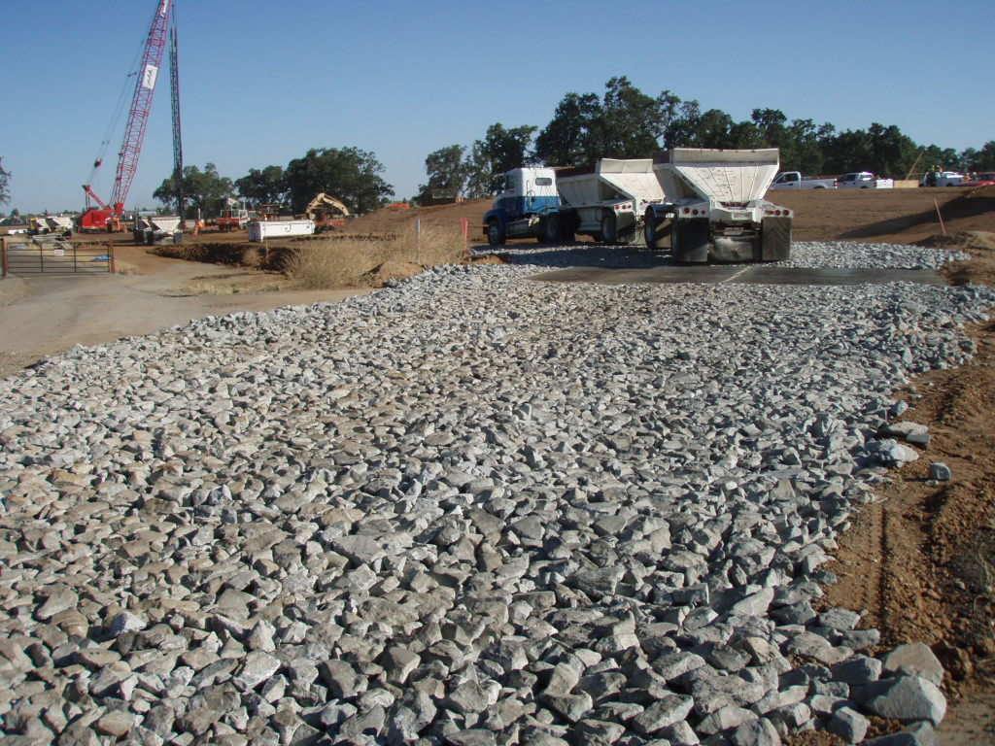
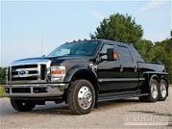
Sediment Control BMPs
Rumble plate
Rock

Slide 31
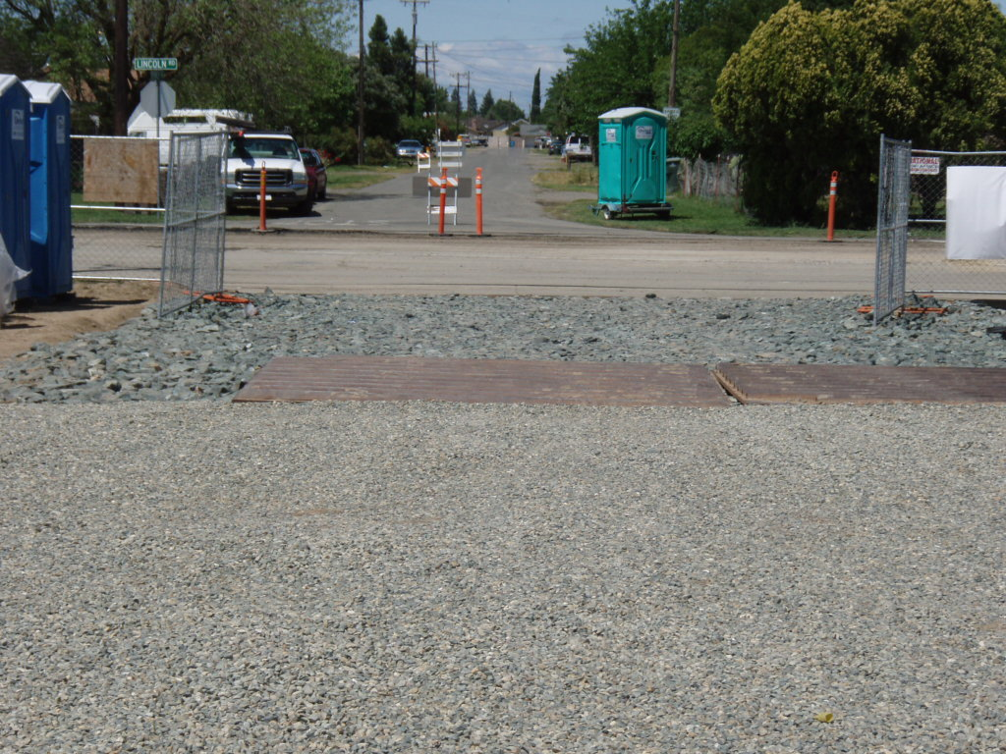
Sediment Control BMPs
Rock
Rumble plate
Gravel
Notes:
Rock pad underlain with a geotextile fabric
10 feet wide – accommodate width of vehicles
16-20 feet long – accommodate two wheel rotations
4-inch to 6-inch angular rock
6 to 12 inches deep layer of rocks

Slide 32
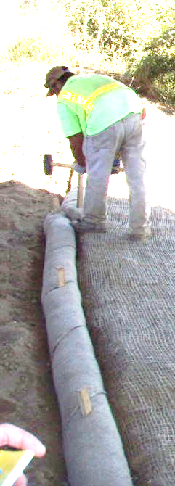
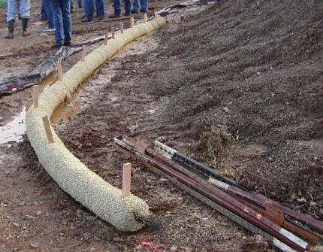
Fiber rolls (wattles)
Type 1 installation
Install in shallow trench
Stakes through wattle hold wattle to the soil
Wattles with plastic nets must be removed.
Use for temporary sediment control only!
Notes:
J-hook ends of roll uphill.
Stakes through wattle hold wattle to the soil
Plastic net – only for temporary installation. Must be removed!

Slide 33
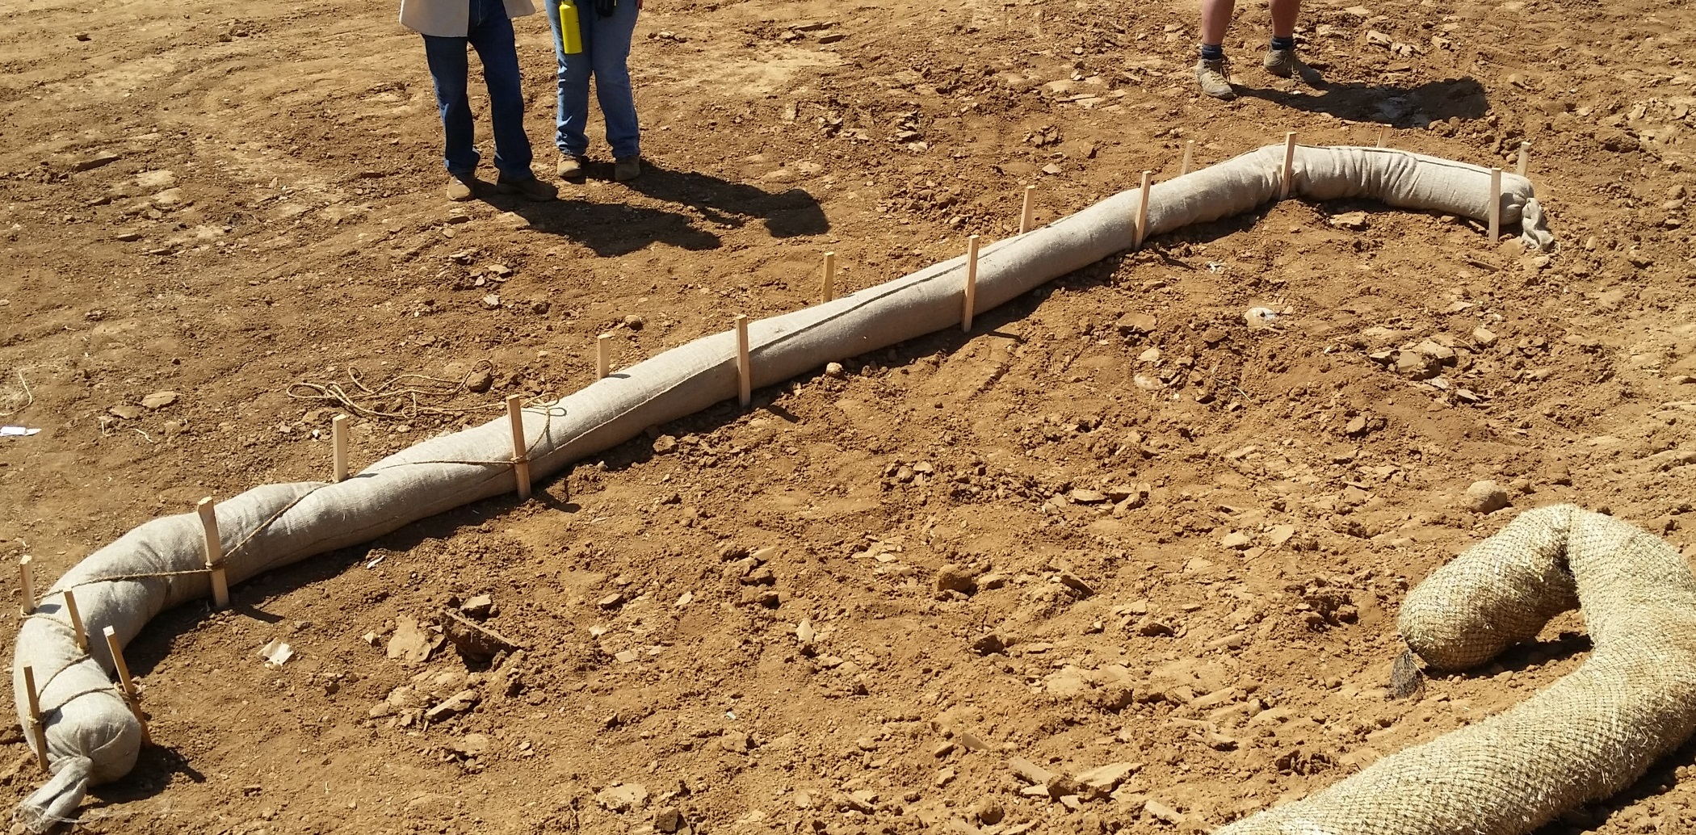
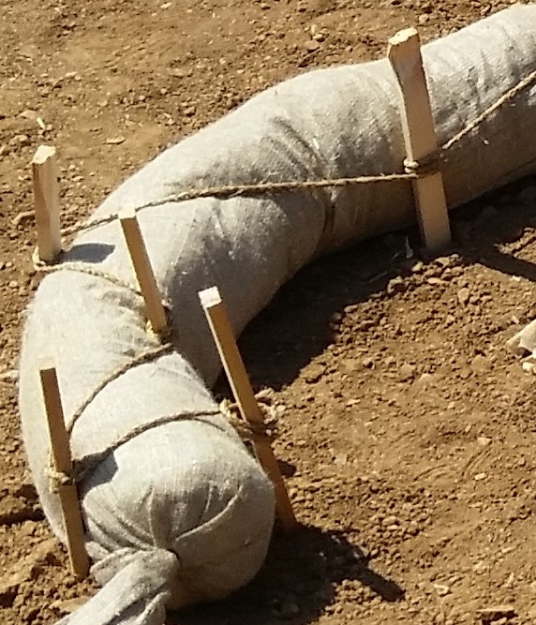
Fiber rolls (wattles)
Type 2 installation
Notes:
J-hook ends of roll uphill.
No trench needed, rope holds roll to soil.
All natural fibers can be left in place at the end of the project
Particularly good on slopes.
Good for long term installations – can be left in place.

Slide 34
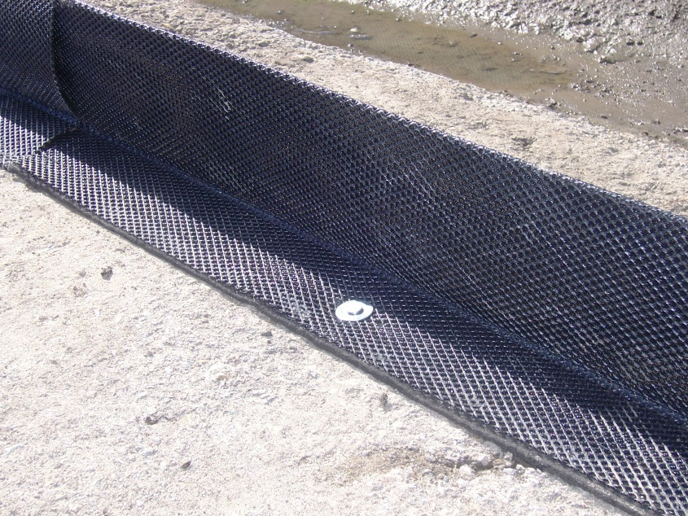
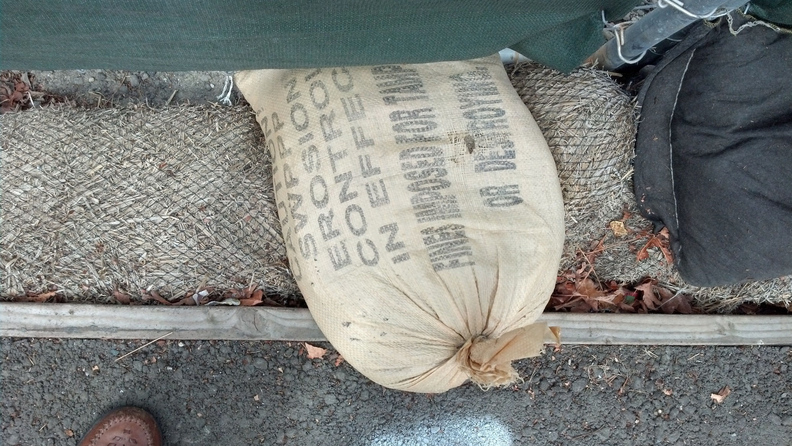
Notes:
Fiber rolls must be staked to be effective. There are two proper method of installing fiber rolls. Neither involve the use of sand or gravel bags. If you cannot stake the wattles a different practice is needed. Several proprietary products have been developed for this type of installation. Dura wattle, Ertec Hard surface guard, shown here

Slide 35
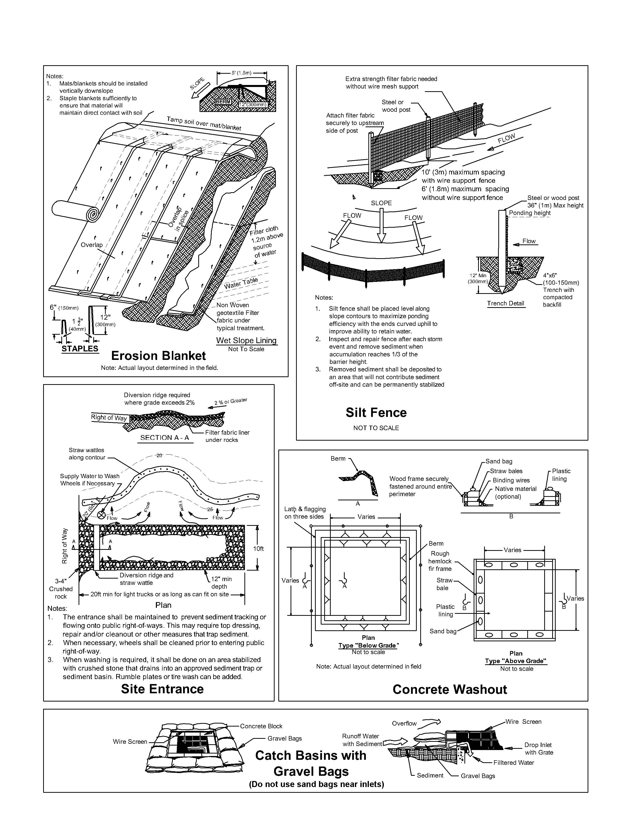
Silt fence – pay attention to the trench

Slide 36
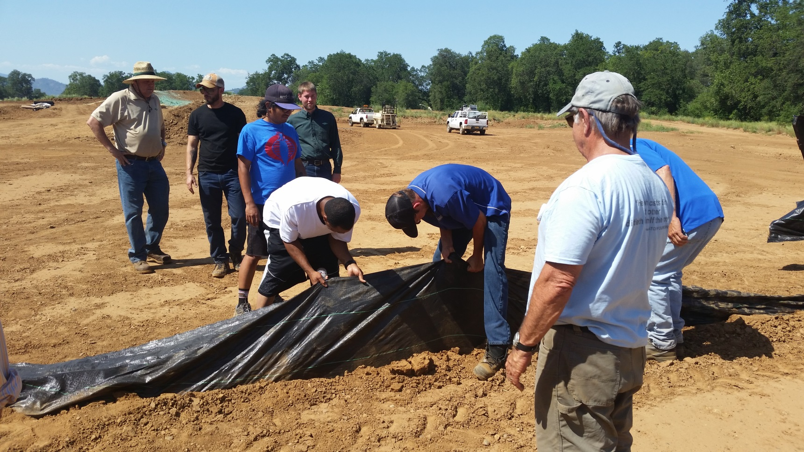
Tug test

Slide 37
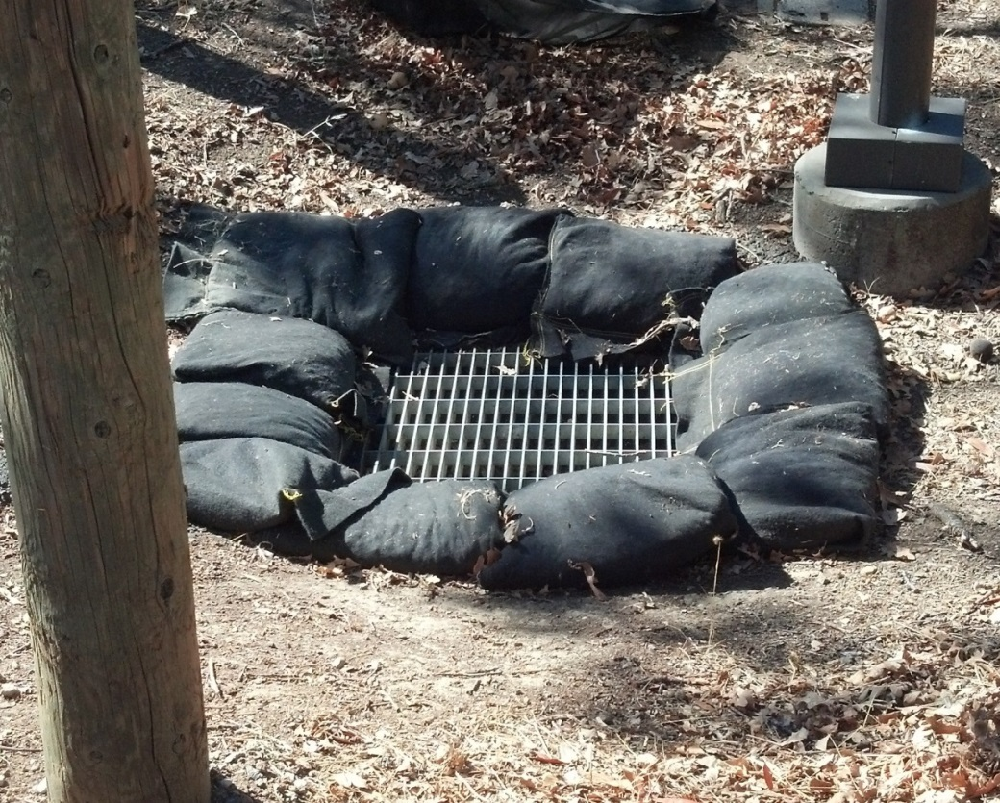
Drain inlet protection last line of defense
Protect drains on-site and immediately off-site
Use woven geotextile bag
  Resistant to photo degradation
Fill bags with washed gravel
  NOT SAND
  NOT DIRT
  NOT ASPHALT
Never use silt fence material to cover an inlet

Slide 38
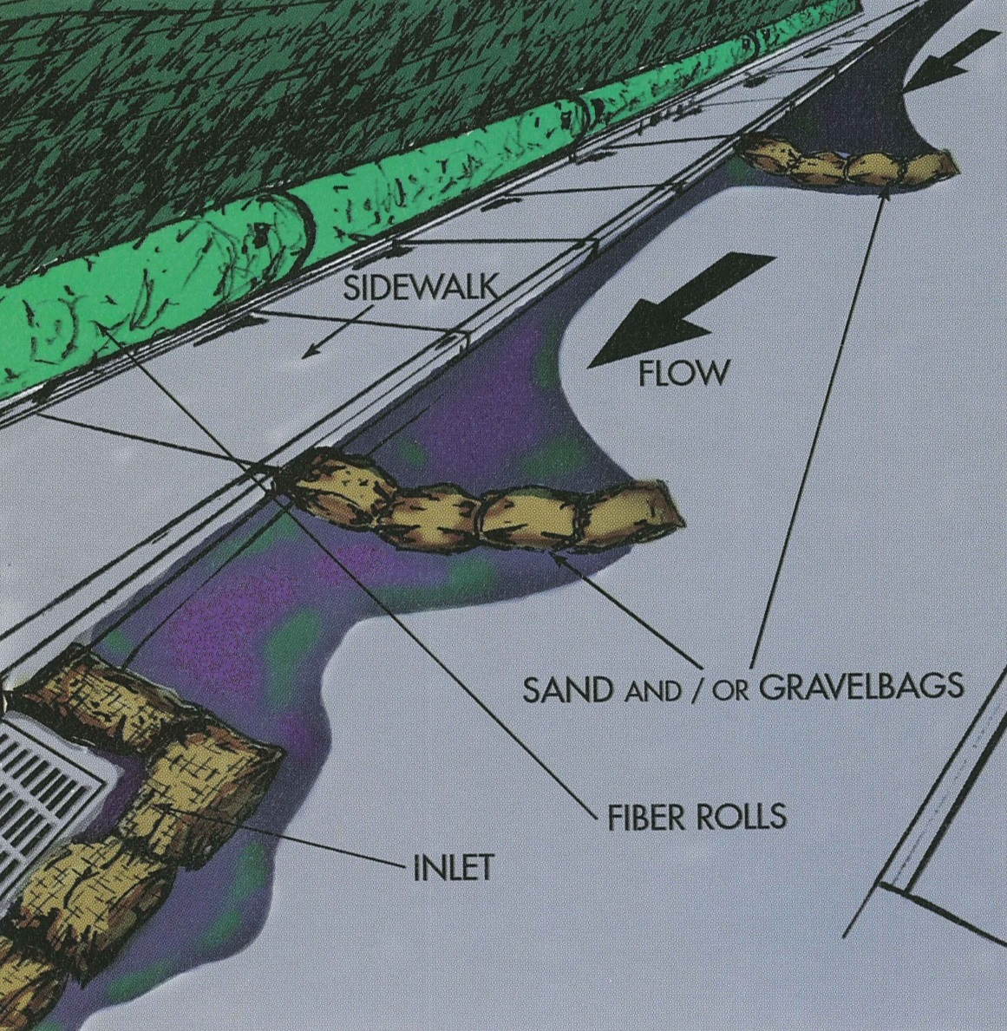
Setting up a treatment train to the drain
GRAVEL BAGS

Slide 39
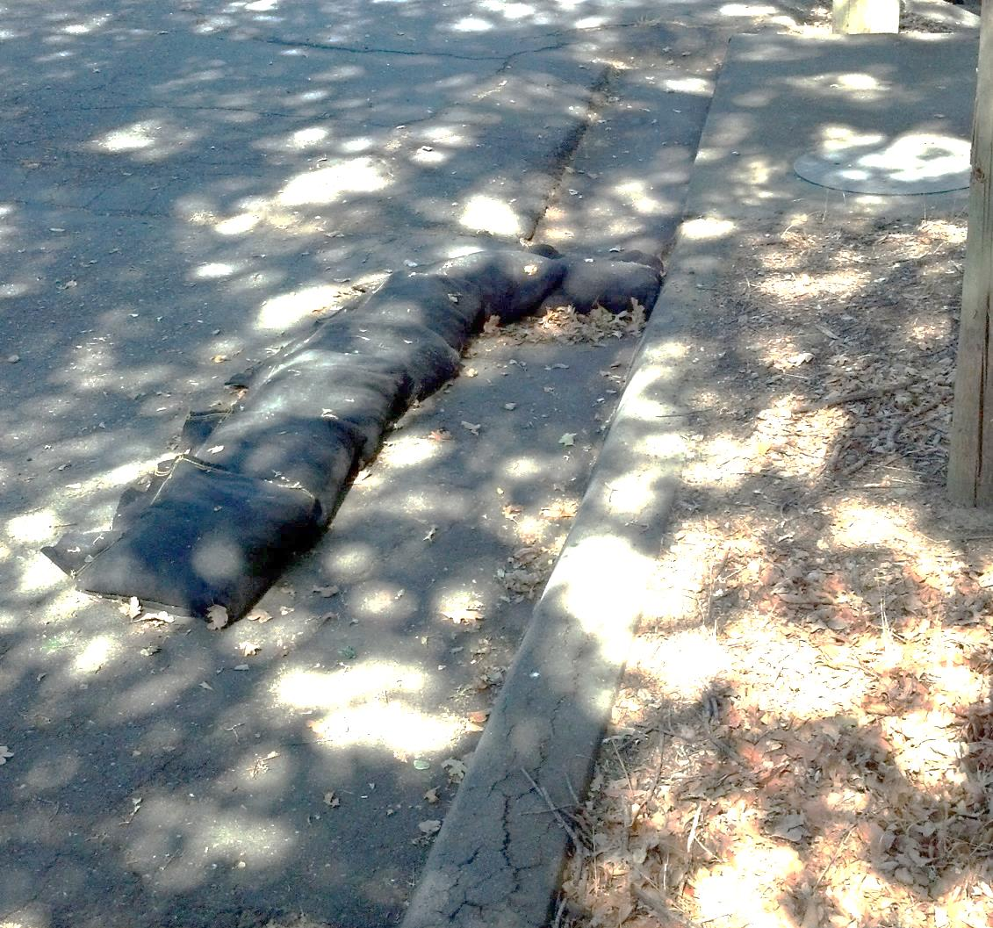
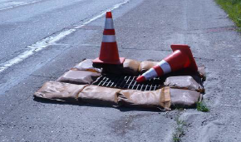
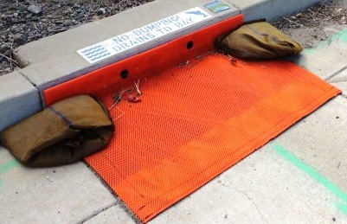
Storm drain inlet protection
Protection at the drain
J-hook check dam along the flow path

Slide 40
Good Housekeeping

Slide 41
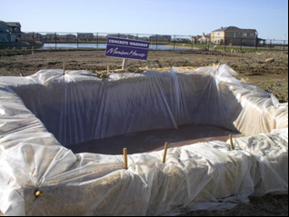
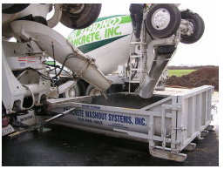
Concrete washout
WashOut

Slide 42
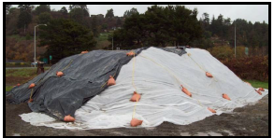
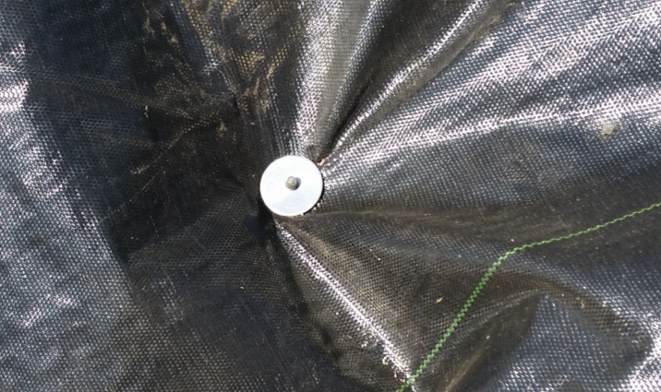

Stockpile management

Slide 43



Hazardous materials management

Slide 44


Sanitary facilities
… what is missing?
Secondary Containment Pans
Stormwater Pollutant Protection

Slide 45


Equipment and Vehicle Maintenance
Avoid conducting maintenance at the job site
Use drip pans, absorbent pads, and tarps to contain drips
Clean up small spills and drips immediately

Slide 46




Waste and litter management

Slide 47
Layers of BMPs
Erosion Control
Sediment Control
Good Housekeeping

Slide 48

MCSTOPPP Minimum Control Measures
* Appendix in Applicant Package
48
Notes:
We will spend more time later today discussing stormwater control measures or as they are more commonly known as Best Management Practices or BMPs.

Slide 49

MCSTOPPP Trench Dewatering BMPs
*Appendix in Applicant Package
49
Notes:
We will spend more time later today discussing stormwater control measures or as they are more commonly known as Best Management Practices or BMPs.

Slide 50


Where to get more BMP info
CASQA California BMP Handbook, Construction
    www.casqa.org
Caltrans Stormwater Quality Handbook, Construction Site BMP Manual
    http://www.dot.ca.gov/hq/construc/stormwater/manuals.htm
Erosion and Sediment Control Field Manual
  San Francisco Bay Regional Water Quality Control Board (2002)
    Out of print

Slide 51

Questions

