Slide 1
Drawdown: Marin
Local solutions to the global climate challenge.
Notes:
[10 min total]
Thank you all for taking time out of your busy days and lives to attend this meeting today.
I am going to provide a quick overview of what we’ll cover today so we can make sure we are all on the same page. ​There are some slight changes from the agenda I originally sent out – hoping that this streamlines our time together.
-First we’ll get ourselves acquainted through a land acknowledgement and an exercise that will allow us to dive deeper into who each of us are
-Then, we’re going to talk about the various frameworks and key issues that we need to address to be successful not only as a group but within the larger Drawdown project and beyond
We get to take a 15 min break. If at any time you want to take a personal timeout for a snack, to walk around, or check your phone, feel free to do it! We want you all to be comfortable.
-Next, we are jumping into what are the opportunities and challenges we face as they relate to increasing our use of renewable energy; we’ll get to show off our ideas for solutions
-We’ll work together to brainstorm goals and strategies for reaching those goals.
-Finally, we’ll close with an overview of our schedule moving forward, meeting format, and our relationship to other Drawdown groups.
​
Before we dive in – I’d love to do a fun exercise!​
​
What ice cream flavor best represents who you are and why? ​
Alex – I’m going to go with Three Twins (started in San Rafael), Dad’s Cardamom. It’s a unique flavor, unusual and slightly unexpected, but also complex and a classic flavor in Eastern cooking. It’s more spicy than sweet, but well-balanced.
Anybody else want to quickly share?
[2 min]
OK – back to the serious stuff:
What is Drawdown?
Drawdown: Marin is a community-driven campaign to do our part to dramatically reduce greenhouse gas emissions and prepare for climate change impacts.
Drawdown: Marin aims to put a comprehensive plan into action and is aligned with State guidance and regulations and the solutions-oriented approach of Paul Hawken’s “Project Drawdown.”
The County, with input and support from the entire community, will work to eliminate fossil fuel use and “draw down” carbon emissions by designing and implementing solutions in 6 Focus Areas:
Renewable Energy, Transportation, Buildings + Infrastructure, Local Food + Food Waste, Carbon Sequestration, Climate Resilient Communities

Slide 2
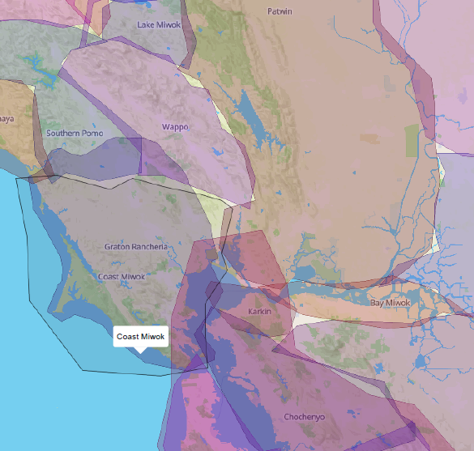
We are on Coast Miwok land.
Notes:
[2 min total]
Before we get into meeting each other and the rest of our time together, it’s incredibly important that we acknowledge the land we stand on today.​
This is Coast Miwok land. The aboriginal land of the Miwok tribe who are the traditional guardians of this land. Their relationship to the land is centuries old.​
​
Respecting indigenous and native peoples, their land, and traditional ecological knowledge is really central to our effort. The solutions we come up with today may not be new or technologically driven. They me based in practices developed by native folks. Indigenous communities have long been on the frontline of resistance against deforestation; mineral, oil, and gas extraction; and the expansion of monocrop plantations. We can and should learn from these efforts!

Slide 3
Reflective Practice:
Centering ourselves in this work
Paseo Circles of Identity – School Reform Initiative
Notes:
[4 min]
As I mentioned, I’m so happy that you all made this meeting a priority today and want to do another exercise to help center us in our work today and moving forward. ​
​
Instead of doing a typical round of introductions, we’re going to try a different exercise to get to know one another.​ It might feel like we’re spending a lot of time talking about our identities rather than Renewable Energy, which is a fair observation. However, in order for our work to be productive, we really need to build trust within our group. I can imagine that it might be difficult for some folks and that this may be new to you all to approach a meeting this way. I appreciate those concerns an am here to make this as easy as possible. If at any point you feel uncomfortable, please let me know.
​
The idea behind this exercise is that before we start to think about what are our challenges, opportunities, and solutions, it is crucial to consider our own identity, beliefs, values, backgrounds, and rank relevant to the people we want to implement these solutions. This is a starting point for equitable decision and policy making. For this we will use a tool called the “Paseo Circles of Identity.”​
​
This exercise was developed by CivicMakers – a SF nonprofit doing really amazing community engagement work across California. ​

Slide 4
Paseo Circles of Identity
Elements of your identity, including:
How you see yourself
How others see you
Ethnicity/ Language
Gender/
Sexuality
Education
NAME
Ability
Socio-
Economic Status
The Paseo Circles of Identity - School Reform Initiative
Notes:
[5 min total]
Let’s get to know each other a little better. ​
​
Write your name in the center circle. Each additional circle should contain a word or phrase that captures some element of your identity — those terms or descriptors that have most helped shape who you are and how you interact in the world. You can also include words or phrases that other people use to identify you. I’ve provided a list of suggested words to get the brain flowing, but feel free to choose your own words. ​
​
If I was filling this out, I would write Alex in the middle and I might choose middle-class, environmentalist, white, wife/sister/daughter, avid runner/yogi. ​
​
Please take 3 minutes to fill out this diagram and then we’ll pair up to discuss.

Slide 5
Reflect on Your Identity 3 mins per person
With which descriptors do you identify most strongly? Why is that?
With which descriptors do others identify you most strongly? How do you feel about that?
Describe a time when one of the elements of your identity definitely worked to your advantage or appeared to hold you back?
The Paseo Circles of Identity - School Reform Initiative
Notes:
Now, I’d love for everyone to reflect on their identity and discuss these questions with a partner (there are 10 of us so we should all be able to pair up) – each person gets 3 min to explain his/her answers.
At ___pm we’ll come back to the large group and debrief.
(6 min total)

Slide 6
Group Debrief
How does examining your identity (both as you see yourself and as others see you) help you in our process to design renewable energy solutions that work for everyone?
The Paseo Circles of Identity - School Reform Initiative
Notes:
Do a few people want to share an answer to this question? ​
​
Alex’s answer:​
​
-I think it is important to consider issues of identity, diversity, beliefs, and values in order to make connections between who we are as practitioners and technical experts and how these things shapes our decisions, tendencies, behaviors, and how we impact those around us specifically through the selection of goals, objectives, and solutions for the Renewable Energy focus area.

Slide 7
Frameworks for Discussion
Systems Thinking
Collective Impact Model
U-Process
Notes:
[2 min]
Part of the reason why we did the last exercise is because Drawdown: Marin is trying to shift old paradigms and examine how we can change our points of view and methodologies for approaching complex problems.
We’re now going to discuss a few of the frameworks that this group and all of the Drawdown groups should consider as move forward with this project. I’m going to give a brief overview of these 3 frameworks: Systems Thinking, Collective Impact Model, and the U-Process.

Slide 8
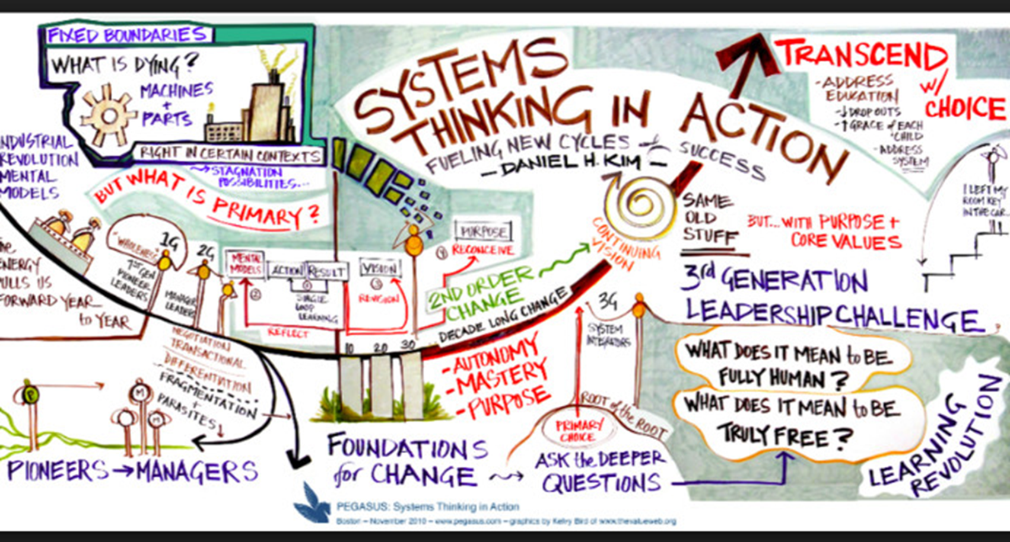
Notes:
[4 min.]
Systems Thinking
This framework replaces reductionism – the belief that everything can be reduced to individual parts with expansionism – a systems is always a sub-system of some larger system. We are all working toward understanding the components of the system and how they work together so that a decision we make in this group doesn’t have unintended consequences for other Drawdown groups and general community efforts. Systems thinking is for everyone – it’s a methodology for innovation. One way for us to better understand this framework is to think about the type of planners each of us may be:
Reactive – embrace the past
Inactive – satisfied with the way things are in the present and to avoid making mistakes within the current system
Preactive – unsatisfied with the past as ell as the current environment and seek change; want to understand all aspects of the future and want to avoid errors of omission
Interactive – the future is the subject to creation; best means of revealing a desirable future is by enabling stakeholders to do it themselves
One of the other key components of systems thinking is that the stakeholders – you all and the community – are the designers. It isn’t the “professional designers or planners” that are the driving force behind change. And as mentioned before one of our jobs here is to understand and incorporate the priorities/views of all community members

Slide 9
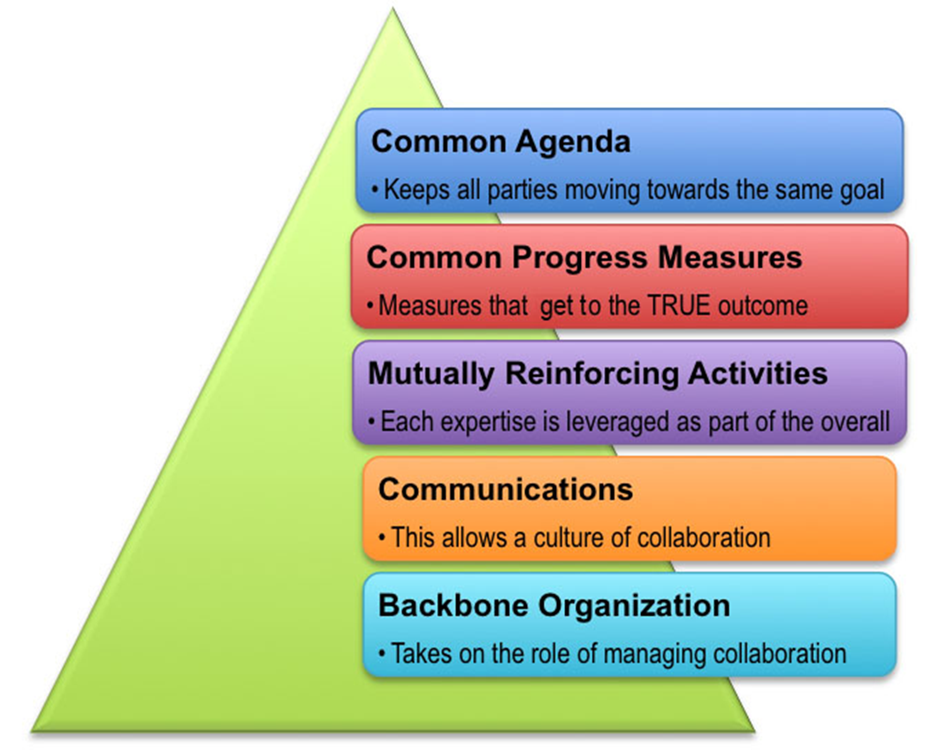
Notes:
[4 min]
Another important model to consider is the
Collective Impact Model
This model is another framework to tackle deeply entrenched and complex problems. This is really focused on making collaboration work across government, business, philanthropy, non-profits, and citizens. The key components of the framework are as follows:
-developing a common agenda (all parties move towards the same goal)
-common progress measures (we want to measure results consistently across all stakeholder collaboratives)
-mutually reinforcing activities (understanding how our activities in this group can support activities from other stakeholder collaboratives)
-communications (on-going and open communications about the entire process, which helps build trust and respect)
-backbone organization (The County is serving as the backbone organization providing staff and resources to coordinate participating organizations and agencies)
The last model I want to discuss is the U-Process.

Slide 10
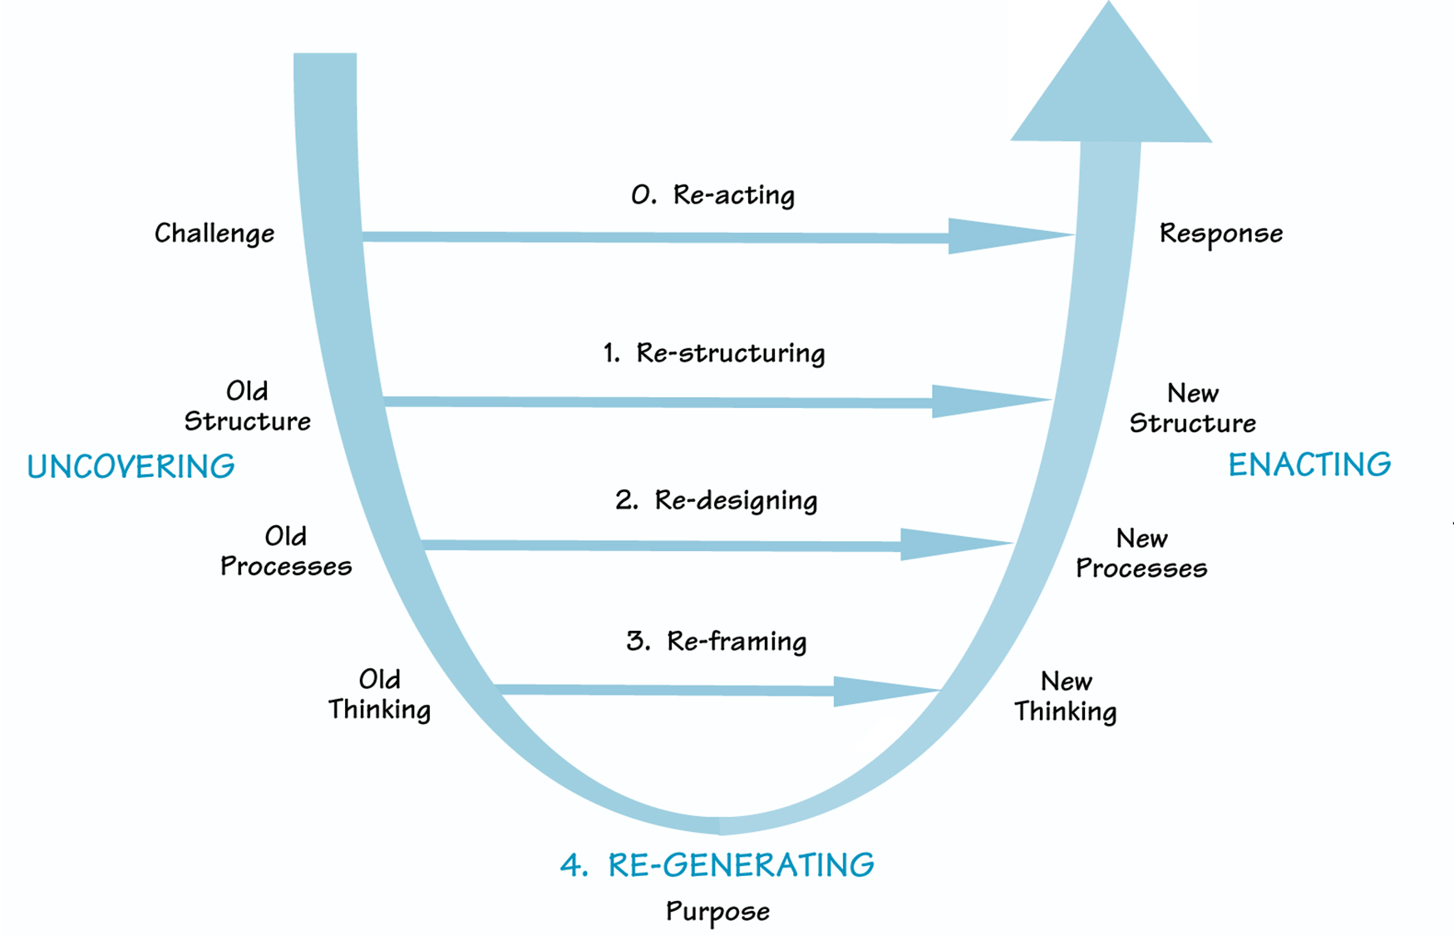
Notes:
[4 min]
The U-Process
This framework says that we can gain insight into tough problems by cultivating certain capacities and the right conditions. These are not new capacities or unique but by the “hyperrational West” has buried them. We often respond to complex problems by deploying solutions that we’re most familiar with, but we really need to respond in a much deeper and more thoughtful way.
The U-Process as 3 phases (sensing, presencing, and realizing) and 7 capacities needed to move through those phases (suspending, redirecting, letting go, letting come, crystallizing, prototyping, and institutionalizing).
The goal is to create the conditions that lead us toward regeneration.
Sensing – uncover the system as a whole and the realities of that system
Presencing – uncover our deeper understanding of what is going on
Realizing – multiple, rapid conclusions that unfold over time – clarity about what we need to do next
The U-process says that we need to just “start” – throw out lots of ideas, see what ones are good ones, try and fail quick and try again.
As a Collaborative, we need to immerse ourselves in the system to understand why is a solution needed, who will it impact, who thinks it’s a bad idea?, who thinks it’s a good idea?, has something like this been done before, what happened?

Slide 11
Recap – Common Themes
Systems Thinking
Collective Impact Model
U-Process
Notes:
[2 min + 5 min for questions]
**to recap, there are several common themes that thread these different models/frameworks together:
-the system is big and we are all interconnected, how will our actions impact all of the system components?
-what are the old structures, paradigms, and feedback loops that we need to be aware of to make real change?
-we are facing tough and complex problems, what are the biases, assumptions, and life experiences that we each bring to the table that might influence our work
-how do we make systemic and institutional change by considering all people and designing solutions with all stakeholders in mind?

Slide 12
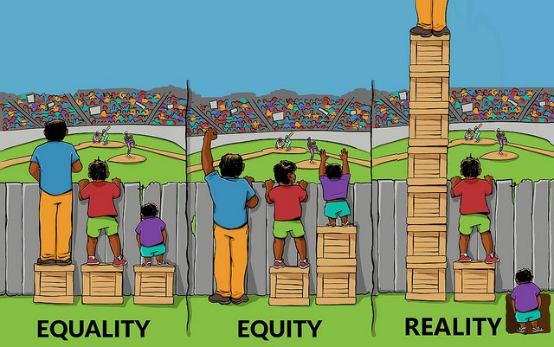
What is Equity?
Can anyone share a definition of equity?
Why does equity matter for our work?
Image from www.thebussonhr.com
Notes:
[10 min]
All of the frameworks we just discussed touch on the idea that we really need to be designing solutions with ALL stakeholders in mind. We need to acknowledge that our current system doesn’t necessarily lead to equitable access to resources. A core tenant of Drawdown and the vision of the Board of Supervisors is to figure out how can Drawdown address those inequities?
The word equity is showing up more and more in state legislation, grant program guidelines, local government plans, and in philanthropic circles. I’m sure we’ve all seen this word in conferences, featured prominently in a plenary session and breakout sessions. Bringing equity to the forefront of peoples’ minds is important but some feel that the word “equity” is being co-opted by organizations that don’t really understand what it means or how to go about achieving it.
A couple of years ago, Stanford asked staff at foundations across the US, some considered to be leading so-called equity work, if there was a common definition of equity. Very few foundations had a clear definition of what equity means internally much less in the field.
The Annie E. Casey Foundation describes equity as distinct from diversity (numerical representation of different types of people) and inclusion (action or state of including or being included within a group or structure). Equity is also different than equality – everyone has the same amount of something despite their existing needs or assets.
I recently attended the County’s Cultural Competency training, required for all County employees. We also talked about what is equity and said, “achieving equity is when identity has no impact on outcome”.
Specifically, race, socio-economic status, gender, etc. should not directly correlate to your ability to achieve your desired outcome. And we all should consider how these components of our identity interplay and prevent us from developing equitable solutions.
Is anyone willing to share a definition of equity they have heard before or one that they use in their work or personal life?
-We don’t need to agree to a single definition of equity, but we all should think deeply about what an equitable future looks like where everyone has access not only to the resources they need now but the resources that are needed to make them “whole” and repair the inequities they have experienced previously.
Why does this all matter for our work?
We have an opportunity to be proactive and be leaders in our community. Drawdown: Marin and you all in this Collaborative can address historical inequities and create a more equitable future by framing the challenges, opportunities, and solutions in a way that is equitable for all people. We can develop solutions that are not just about using 100% renewable energy but take into account other parts of the “system” we talked about before. For example, how can all people realize the environmental and financial benefits of using 100% Renewable Energy?

Slide 13
Participation Pledge
A formal promise to actively participate in this group
Helps create a shared vision for our work
Increases our accountability to each other
Notes:
[8 min]
So, we are all in this together and to really formalize this, we are all going to make a formal pledge to one another to be active and thoughtful participants in this working group moving forward. This pledge will ensure that we have shared visions for our work together and that we are accountable to one another.
Some key components of the pledge I wanted to highlight:
Step up and Step Back – I encourage you to think about your fellow group members. Take a moment to look around and evaluate if there are folks who haven’t had a chance to speak and consider taking a step back so they can step up and share.
“And” instead of “But” – be kind and respectful to others by responding to ideas or comments using the word and instead of but. If you disagree try saying “Thanks Robert for your idea and I think we should also consider this… vs. Thanks Robert for your idea but it won’t work because…
Reaching consensus – we will discuss complex issues and we may not agree on everything. That’s OK – agreement and disagreement are on a fluid spectrum. We all don’t need to be 100% on board with everything that comes out of this group. That being said, I’d like permission from the group to step in and put ideas that are causing us to stall as a group into a parking lot. Where we can revisit these notions later either one-on-one, during our small group meetings that I will discuss later, or at a future meeting. I’d also like permission from the group to keep us on track so we can be most effective during our time together. I may ask you to raise your hands to quiet the group or clap. Is that OK with everyone?
Great! So, can someone read the participation pledge out loud?
Now we’re going to pass around the pledge and I’d like everyone to sign it. I’ll bring this to every meeting we have moving forward to remind us of our promise to each other.

Slide 14
Housekeeping
Today’s meeting and future meetings
Document sharing
Attendance
Notes:
Meeting 1- Purpose of today’s meeting is to get ourselves oriented with the work and each other, sign our pledges, brainstorm our biggest opportunities, challenges, and solutions, set goals and objectives. And be clear about what are next steps and the Drawdown schedule.
After today, we will have 4 more meetings.
Meeting 2 – Small Group Meetings, members choose format (coffee meeting, yoga and a smoothie, stroll at the Farmers Market) with guidance from Drawdown Coordinator to ensure diverse opinions/expertise; Each group is assigned up to 3 potential solutions to vet. In these small group meetings members will discuss what are:
-knowledge gaps and research needs,
-potential partners,
-funding opportunities
Small group meetings will happen independently, and Drawdown Coordinator will not attend but provide tools needed for those breakouts.
Key Outcomes:
1-page brief for each solution/opportunity – what are knowledge gaps and research needs, potential partners, funding opportunities, priority level (near, mid, or long term) and benefits (more to come on this front later in the meeting)
Meeting 3 – We’ll reconvene as a big group and each small group will present to the full Collaborative. We will also discuss ranking criteria, rank all solutions. Develop metrics for each solution – how will we measure impact?
Meeting 4 – Drawdown Coordinator presents to SC: summary of community input and recommended changes to priority solutions.
Key Outcomes:
Final tweaks on 1-pagers
Meeting 5 – Present overview of process, ranked solutions, and solution metrics to Executive Steering Committee (ESC) and receive feedback.
Key Outcomes:
Open dialogue about the SC’s process and findings
List of required/suggested changes
Document sharing
Google docs! I will send out a link to the Drawdown: Marin folder on Google Drive and we can access all document related to our meetings there.
Attendance
As part of the Participation Pledge we just signed, we all agreed to be physically and mentally present at the meetings. If you cannot attend or have an emergency, you must notify me and arrange to “make up” the work you’ve missed. There may be a call-in option available for extenuating circumstances.

Slide 15
BREAK
Image from www.mainecoonexpert.com

Slide 16
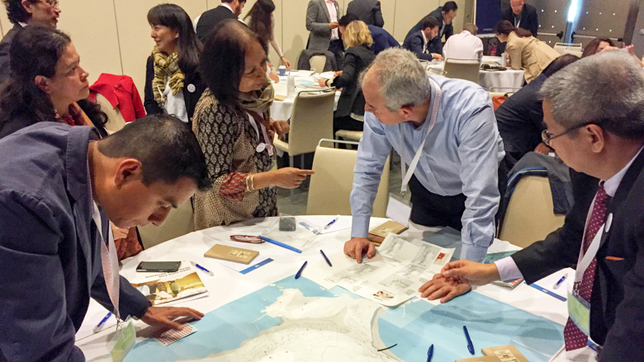
Time for fun! Conversation Mapping Exercise
Allows us to gather a large amount of information from a diverse group of stakeholders in a short amount of time
Illuminates how different challenges, opportunities, and ideas are connected
15 minutes to share your thoughts!
Notes:
[4 min] (video is 2:09)
OK! We’ve been talking about a lot of serious things, and now we get to have some fun.
Who here has heard of conversation mapping?
We’re going to watch a short video to learn more – see if you can spot the local celebrity!
https://www.youtube.com/watch?v=uqwL4k2easU

Slide 17
Drawdown Solutions
We need a plan to “draw down” carbon
There are hundreds of solutions that are available to us right now
We need to think big!
But first, what are we already doing in Marin County?
Notes:
[
We need a plan to draw down carbon and we need to put that plan in action. There are hundreds of solutions that are technically feasible and viable right now, but what ones make sense for us to focus on?
Who here as read Project Drawdown? If you want to skim during our break, it’s right there (point to book).
The book is intended to be solutions oriented and show us a path toward a decarbonized future. Project Drawdown gathered a qualified and diverse group of researchers from around the world to identify, research, and model the 100 most substantive, existing solutions to address climate change. What was uncovered is a path forward that can roll back global greenhouse gas emissions within thirty years. Our work here today and the Drawdown: Marin project draws from this book and the solutions-oriented framework. Personally, the book really resonates with me because it is more holistic, focuses on people, and elevates women, indigenous communities, and nature-based solutions.
My favorite solutions –
Educating girls
Afforestation
Indigenous Peoples’ Land Management
Do you have favorite solutions or solutions you are most excited about from the book?
Great, thank you for sharing these solutions. A common thread through these solutions is that they are BIG solutions. Significant undertakings. I want you to remember the nature and scale of the solutions we just discussed as we move forward today. Think about how these solutions relate to the goals and objectives for our work in the RE group.
So! We know we need to select BIG solutions that rapidly and dramatically draw down carbon, but to understand what those solutions are and what makes sense for Marin, we also need to have a baseline or understand what is already going on in Marin right now. I am going to name some of the existing initiatives but I invite folks to quickly share – 1 min each – other initiatives that I may have missed. I am going to write down the initiatives you shout out and will send out a full list after the meeting.

Slide 18
What can we do?
Your top 2 solutions and more?
Every idea is a great idea!
30 minutes to brainstorm
Image from www.recurrentenergy.com
Notes:
[5 min to introduce the topic + 30 for the exercise]
I hope you all feel excited about brainstorming solutions that are BIG and that will work in Marin and for our neighboring communities.
I’ve asked you to bring with you your “top 2 solutions” for achieving 100% Renewable Energy in Marin. No idea is a bad idea. You can draw from your own research, from the amazing Renewable Energy Resource list developed by the RE Learning Group (on your table), Project Drawdown, or any other source. Please also consult the tables where we spent time identifying our biggest opportunities and challenges. The idea is that the solutions we end up choosing as a group will tie back to the ideas we all wrote down on the butcher paper.
There are post-it notes on the table and markers. Please clearly and concisely write your proposed solution on a post-it note. Feel free to share/discuss amongst yourself. Once you have written your top solutions down, each solution on a separate note, please walk up to the chart and place it on the diagram in the appropriate quadrant. For example (Alex writes down a solution and puts it in the correct quadrant). This diagram will help us understand the potential impact of the solutions we choose and also helps tie back these solutions to the concept of equity that we discussed earlier in our meeting.
**Explain quadrants: “Good for only Marin County”, “Good for only Others”, “Designed Will All People in Mind” and “Designed with a Select Few in Mind”
We have 35 minutes to do this and I will give you 10 and 5 min warnings.
Does anyone have questions?

Slide 19
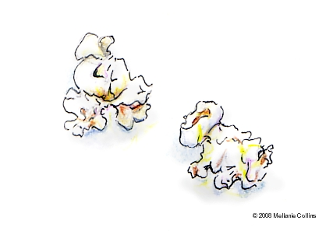
Our Goals
Overarching goal of Drawdown: Marin
What do we want to achieve?
Visual goal-setting, popcorn style!
Notes:
[10 min for What are Goals + 40 min. for visual goal setting/caucus + 15 min. for breakouts and 10 min for group debrief)
What is the overarching goal of Drawdown:Marin.
I’ll suggest one to get us started:
Marin reverses its impact on the climate, powering our lives with clean energy and sequestering more GHGs than we emit, as we transition to a thriving, equitable, and resilient future for all.
How do we set goals for this group? Let’s try using the SMART framework. Goals should be:
Specific
Measurable
Achievable
Results-focused
Time-bound
Sample goals:
All electricity demand for buildings and infrastructure in Marin County is provided by renewable energy via Marin Clean Energy’s Deep Green program by 2022.
All commercial buildings have battery back-up that can store renewable energy and be used in the event of a power outage, during times when the renewable energy system is not producing power, and for demand reduction by 2030.
Each Stakeholder Collaborative needs to choose 3 goals. Remember, not everyone has to agree 100%. We need to build consensus for 3 goals that most of us are excited about and can support.
What do we want to achieve? Popcorn style – you shout goals out and I draw them.
Goal Caucus
-First we have a primary and vote for our top 5 goals
-Second, folks can persuade others to choose their favorite goal
-Third, we vote again to select the top 3

Slide 20
How do we achieve our goals?
Realistic objectives
Things to consider:
Time frame
Needed actions
Who’s responsible?
What resources do we need?
Small group breakouts – 2 objectives for each goal.
15 minutes to brainstorm, 10 minutes to debrief.
Notes:
3 breakout groups – choose 2 objectives for each goal
We have 15 min to discuss among ourselves and each group will have 3 minutes to explain what objectives they came up with…

Slide 21
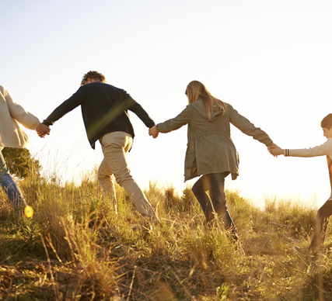
Schedule + Next Steps
Our meeting schedule
Small group meetings
Drawdown structure
Questions?
Notes:
[13 min]
Our meeting schedule (recap form previous slide):
Small group meetings – between 11/26 and 12/14 (Alex available via email and phone if you have questions)
Second all group – week of 12/31
Community engagement – 12/31 – 1/31
Summary of initial community input and recommendations to SC – week of 2/4
Presentation to ESC – week of 2/18
If anyone knows they will have a conflict with an upcoming meeting, please let me know. If anyone has an issue with the
Small group meetings – the purpose of these meetings is to create some flexibility in how we meet and to allow for more robust one-on-one conversations.
After this meeting, I will take note of all the solutions we brainstormed together – all of the post-it notes on the chart there. I will assign 2-3 solutions to each group. In these small meetings members will:
-gather data on the proposed solution,
-refine and develop solutions,
-understand feasibility and co-benefits,
-describe prototyping process, or how we would implement the solution
-understand how much the solution might cost to implement
-who are the key partners needed to implement this solution
I will not be present at these meetings but will provide you with instructions and a guided document for note taking so that each small group is gathering and recording information in the same way.
I’d love for you all to form these small groups now, no need to move around, but identify who you’d like to met with – ideally 3-4 people per group. Some ideas for small meetings:
-Pastry and Coffee @ Arizmendi
-Potluck dinner
-Yoga and coffee
-Hike and chat
These meetings will take place between 11/26 and 12/14. I will be available via email to help if anything comes up. We will use Google Drive to share documents and access resources needed for these groups.
I also wanted to provide you an overview of the Drawdown structure so that you can understand how the Stakeholder Collaboratives will work together and with the Community Partnership Council and Executive Steering Committee.

Slide 22
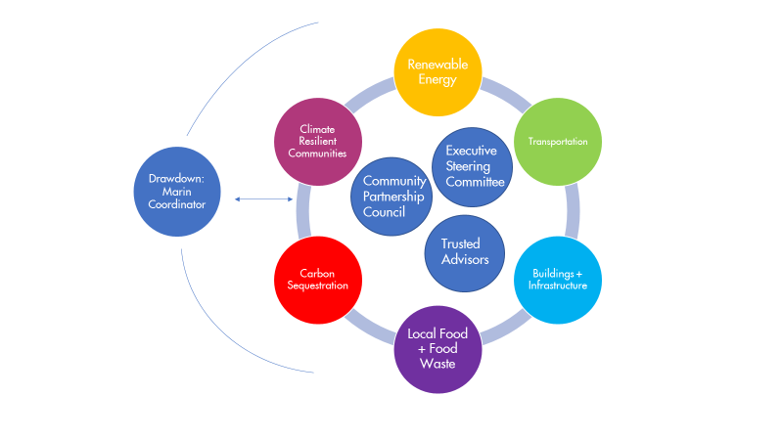
Notes:
-Explain about coordination between the groups

Slide 23
Notes:
[2 min]
I wanted to end our time together on a positive note by sharing with you something I am grateful for and invite anyone who wants to to do the same.
I am grateful for the opportunity to practice my facilitation skills and learn from you all what I could have done better.

