Slide 1
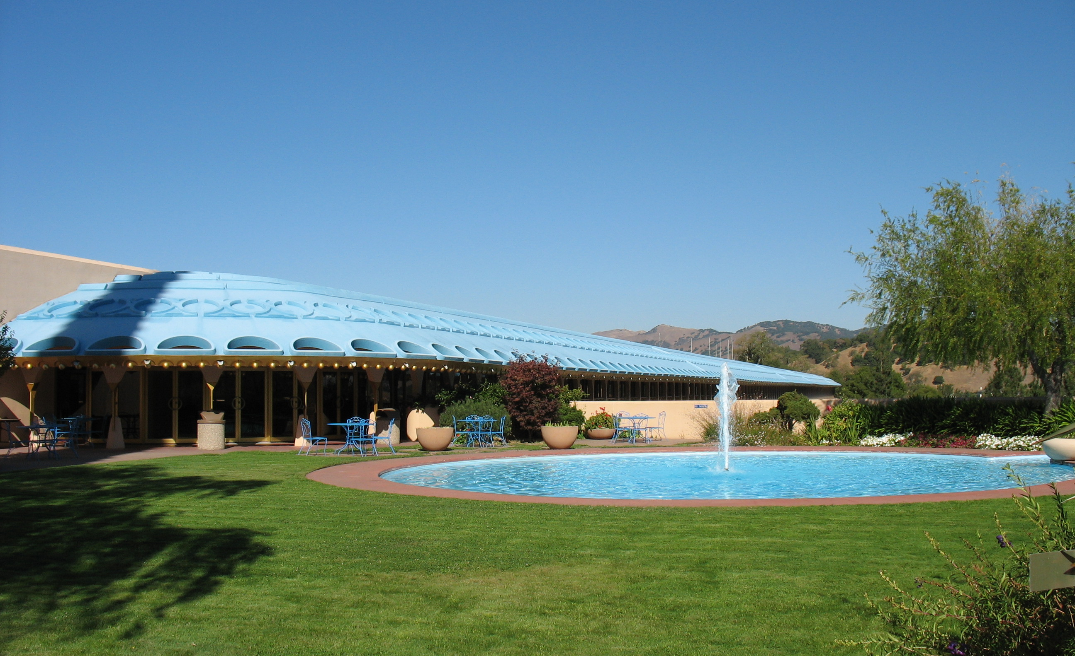
Federal Grants Funding Recommendations 2019-20
Public Hearing To Review and approve funding recommendations
Tuesday, May 7, 2019
Photo Credit: Jeff Wong

Slide 2
Agenda
Action items for Public hearing
Hold a public hearing on May 7, 2019, for comment on:
  Marin County's housing and community development needs.
  Marin County's community development performance.
  The Consolidated Plan Amendment 2019 Annual Action Plan, including activities proposed for federal fiscal year 2019 funding from CDBG and HOME.
  The proposed budget for the use of federal fiscal year 2019 CDBG funds included in the Consolidated Plan Amendment 2019 Annual Action Plan.
  The proposed reprogramming of past years’ CDBG funds to new activities and the proposed use of CDBG program income included in the Consolidated Plan Amendment 2019 Annual Action Plan.

Slide 3
Agenda continued
Action items for Public hearing
  The proposed budget for the use of federal fiscal year 2019 HOME funds included in the Consolidated Plan Amendment 2019 Annual Action Plan.
  The proposed reprogramming of past years’ HOME funds to new activities and the proposed use of HOME program income included in the Consolidated Plan Amendment 2019 Annual Action Plan.
  Local Policies and Procedures, including:
    The Local Standard for Affordable Rents.
    The Civil Rights Policy.
    The Residential Antidisplacement and Relocation Assistance Plan.
    Notice of Nondiscrimination Policy.

Slide 4
Agenda continued
Action items for Public hearing
Following public testimony, approve the Consolidated Plan Amendment 2019 Annual Action Plan and related documents, in substantially the form attached, including the items listed above, and authorize any budget changes necessary to implement these actions.
Following public testimony, approve the Resolution authorizing staff to submit the Consolidated Plan Amendment to the U.S. Department of Housing and Urban Development (HUD), and authorize staff to act in connection with the submission of the Consolidated Plan Amendment 2019 Annual Action Plan and to provide such corrections or additional information as HUD may require.
Announce that copies of the Consolidated Plan Amendment 2019 Annual Action Plan (as amended) are available from the Community Development Agency, and that program files, records regarding past use of CDBG and HOME funds, the Local Standard for Affordable Rents, the Civil Rights Policy, the Residential Antidisplacement and Relocation Assistance Plan, and the Nondiscrimination Policy are available for inspection at the Community Development Agency.

Slide 5
Funding Priorities
National and Local Priorities and eligibility
General Eligibility and Priorities—project must meet the following national and local objectives:
Benefit low- and moderate-income persons;
Affirmatively Further Fair Housing and have the commitment and capacity to engage in Affirmative Marketing;
Serve members of the protected classes; and
Prioritize funding fewer applications.
Public Service Specific Priorities:
Basic health services
Childcare and parenting services
Fair housing services and Legal services
Senior services

Slide 6
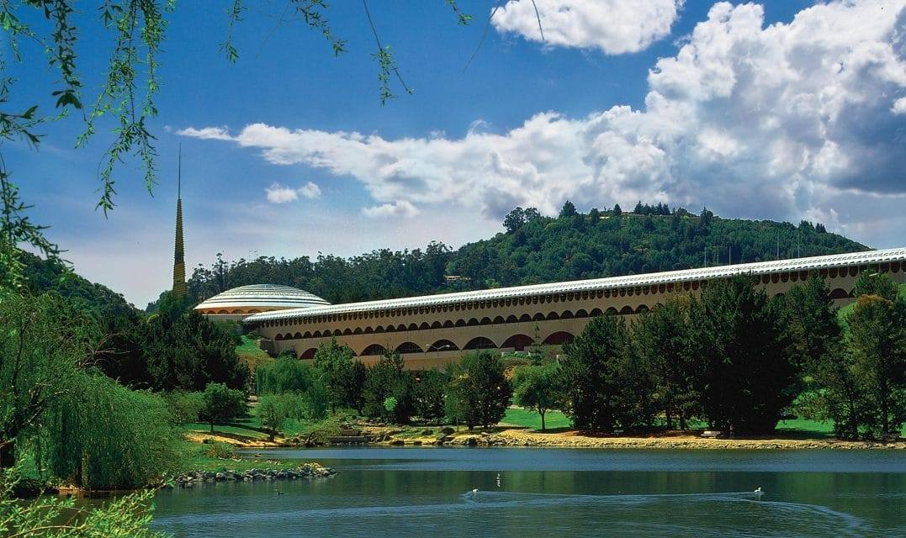
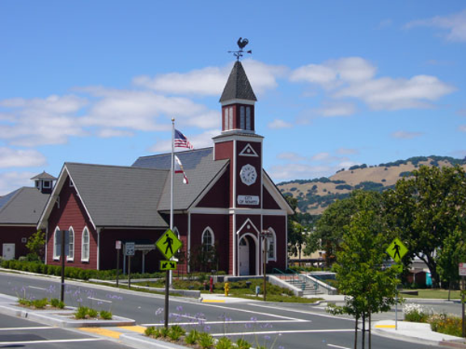
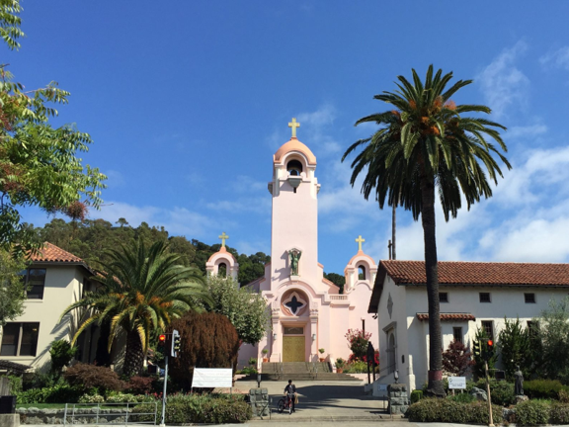
Federal Grants Program
overview Continued
Three (3) Planning Areas:
County Other
Novato
San Rafael
Four (4) decision making bodies:
Novato & San Rafael City Councils
Countywide Priority Setting Committee (community members representing protected classes and city, town and County representatives)
Board of Supervisors
Notes:
Discuss: Marin is an Urban County and Cooperation Agreement with all cities, towns, and the County

Slide 7
2019-20 Applications & Funding Awards
All Planning areas
Applications received:
CDBG 40 HOME 4
Funding Requests received:
CDBG $3,046,590 HOME $2,183,212
Funding Available:
CDBG $1,505,533 HOME $742,490
Funding Available by Activity:
Housing $491,106
Capital Projects $292,647
Public Services $278,969

Slide 8
Additional Resources
Post Planning Area Approvals
Entitlement funding from HUD by Activity:
Community Development Block Grant (CDBG) $12,248
  Capital or Housing $7,961 (minimum)
  Public Services $1,837 (maximum)
HOME Investment Partnership Program $74,229
  HOME projects $66,806
Program Income
CDBG $11,152 (restricted to San Rafael Planning Area)
HOME Projects $7,728
Reallocated CDBG Administration
CDBG Capital or Housing $70,852

Slide 9
Options for Additional Funds
2019-20 Funding recommendations
Proportionally increase the grant awards set at the local planning area, up to the full grant request; or
Consider allocating the additional funds to the following projects:
  Countywide Projects –
    $7,961 of CDBG entitlement funding to the New Marin City Mixed-Use Health Hub, a project of the Marin City Health and Wellness Center.
  County Other Planning Area
    $10,000 of CDBG entitlement funding and $3,077 of CDBG program income to Mesa and Ocean Terrace Apartments, a project of the Community Land Trust Association of West Marin.
    $1,837 of CDBG entitlement funding to the After School Transportation Program, a project of Fairfax San Anselmo Children’s Center. This is the full amount available for public service from the additional entitlement received.

Slide 10
Options for Additional Funds continued
2019-20 Funding recommendations
  County Other Planning Area continued
    $10,000 of CDBG entitlement funding to Creating Healthy Environments Through Infrastructure, a project of Marin City Community Services District.
    $6,144 of CDBG entitlement funding to Sage Lane Senior Affordable Housing Rehabilitation, a project of San Geronimo Valley Affordable Housing Association.
  Novato Planning Area
    $7,778 of CDBG entitlement funding to the Rehabilitation Loan Program, a project of the Marin Housing Authority.
    $9,000 of CDBG entitlement funding to an Elevator Modernization, a project of North Marin Community Services.

Slide 11
Options for Additional Funds continued
2019-20 Funding recommendations
  San Rafael Planning Area
    $27,930 of CDBG entitlement funding and $11,152 of CDBG program income to Art Works Downtown Affordable Housing Electrical Upgrade, a project of Art Works Downtown.
  HOME
    $20,363 of entitlement funding and $7,728 of program income to Centertown Apartments, a family rental project of BRIDGE Housing and EAH Housing.
    $46,443 of entitlement funding to Victory Village, a senior housing project of Resources for Community Development.

Slide 12
Recommended Actions
Federal Grants Funding Recommendations 2019-20
Hold a public hearing and receive public testimony.
Approve the Consolidated Plan Amendment 2019 Annual Action Plan and related documents, in substantially the form attached, including the items listed above, and authorize any budget changes necessary to implement these actions.
Approve the Resolution authorizing staff to submit the Consolidated Plan Amendment to the U.S. Department of Housing and Urban Development (HUD), and authorize staff to act in connection with the submission of the Consolidated Plan Amendment 2019 Annual Action Plan and to provide such corrections or additional information as HUD may require.
Announce that copies of the Consolidated Plan Amendment 2019 Annual Action Plan (as amended) are available from the Community Development Agency.

Slide 13
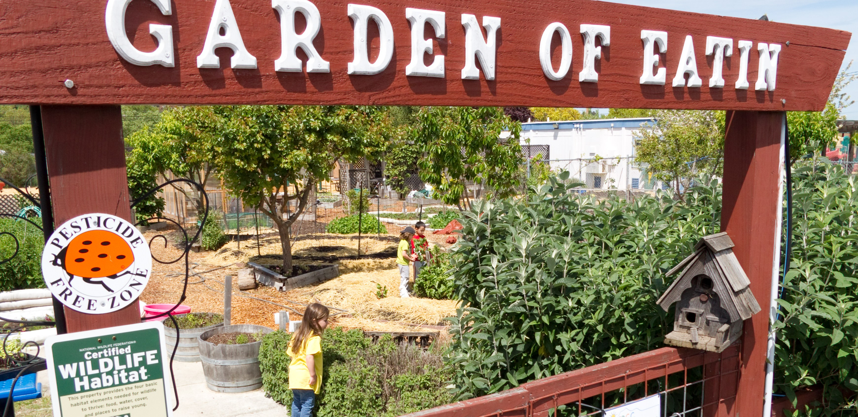

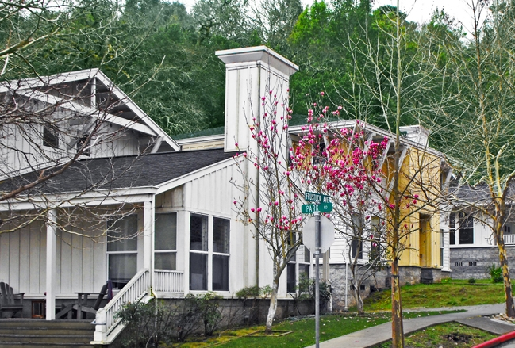
Federal Grant Funding
Recommendations
Public Comment

Slide 14
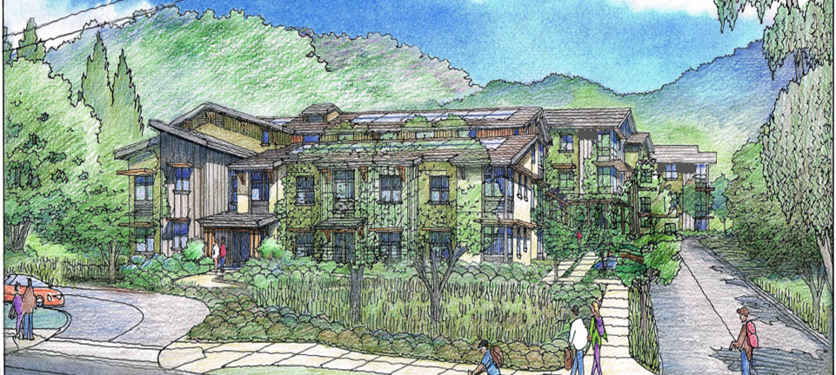
Thank You
Housing and Federal Grants Division
Leelee Thomas, Planning Manager
lthomas@marincounty.org
Molly Kron, Planner
mkron@marincounty.org
Jillian Zeiger, Planner
jzeiger@marincounty.org
Genevieve Hahn-Kerr, Budget and Grants Analyst
ghahnkerr@marincounty.org

